Slide 1
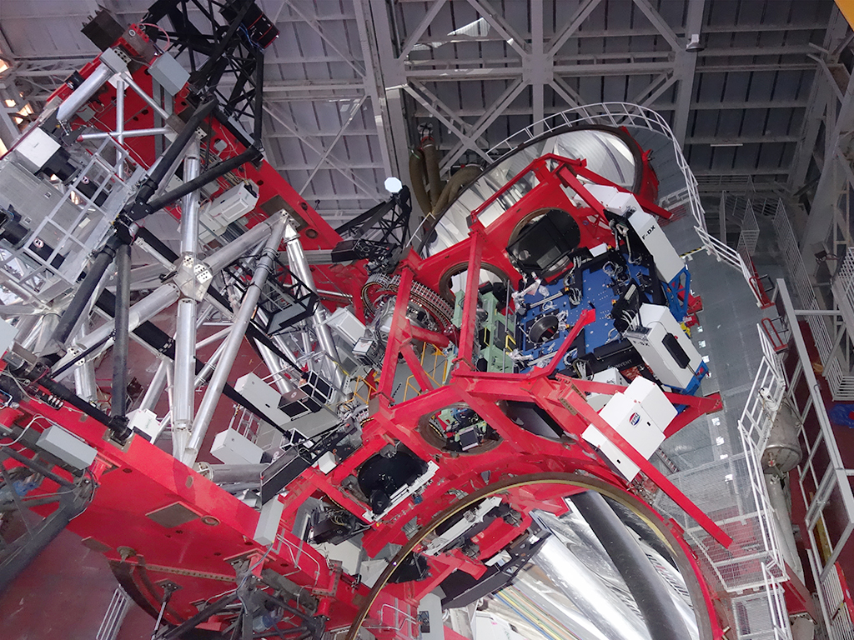



LINC-NIRVANA on its way to the sky

Slide 2
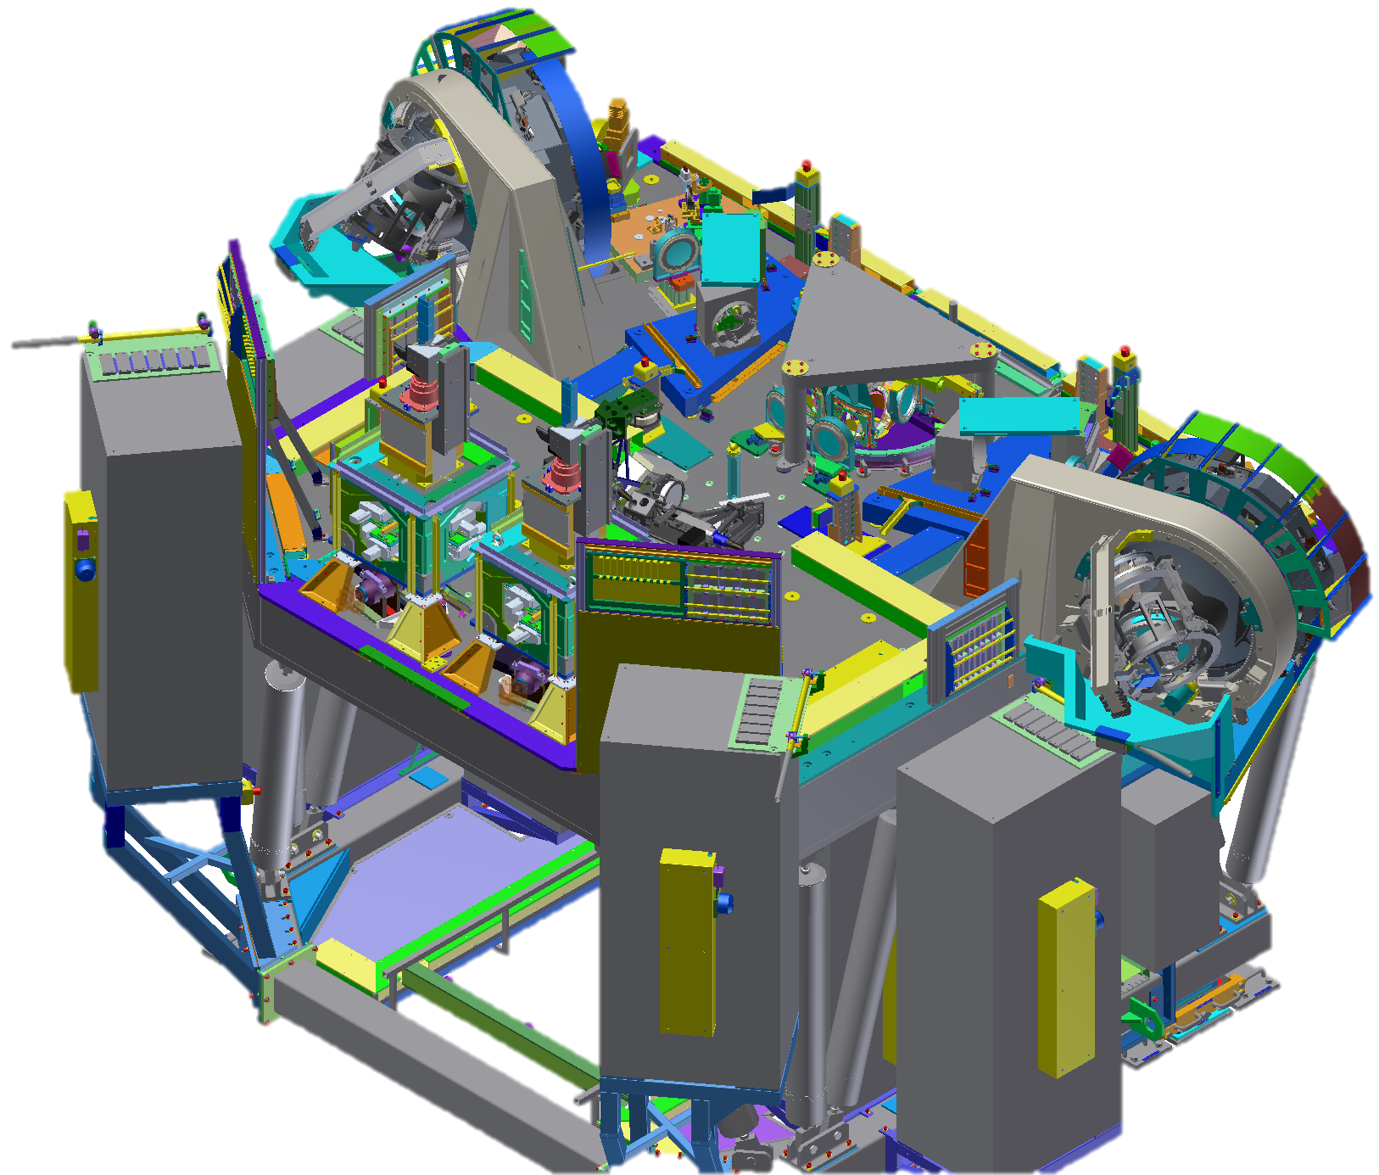
What is LINC-NIRVANA
High Resolution, NIR Imager:
MCAO, Interferometry
λ: JHK
Platescale: 5.11 mas/px
Resolution: 10 mas (J)
15 mas (H)
20 mas (K)
FoV: 10.5 x 10.5 arcsec

Slide 3


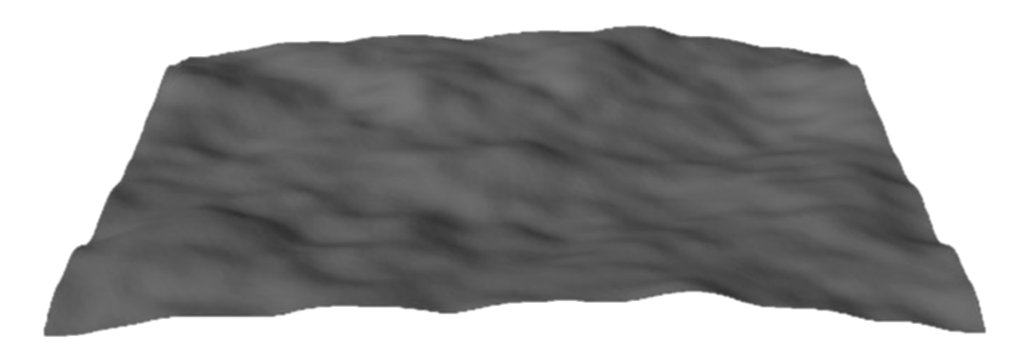

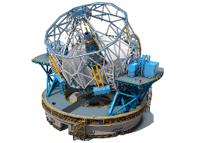
Wide FoV for low layers
Narrow FoV for high layers

Slide 4
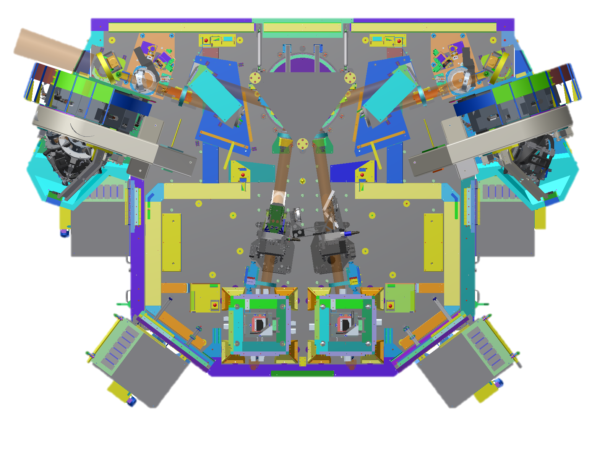
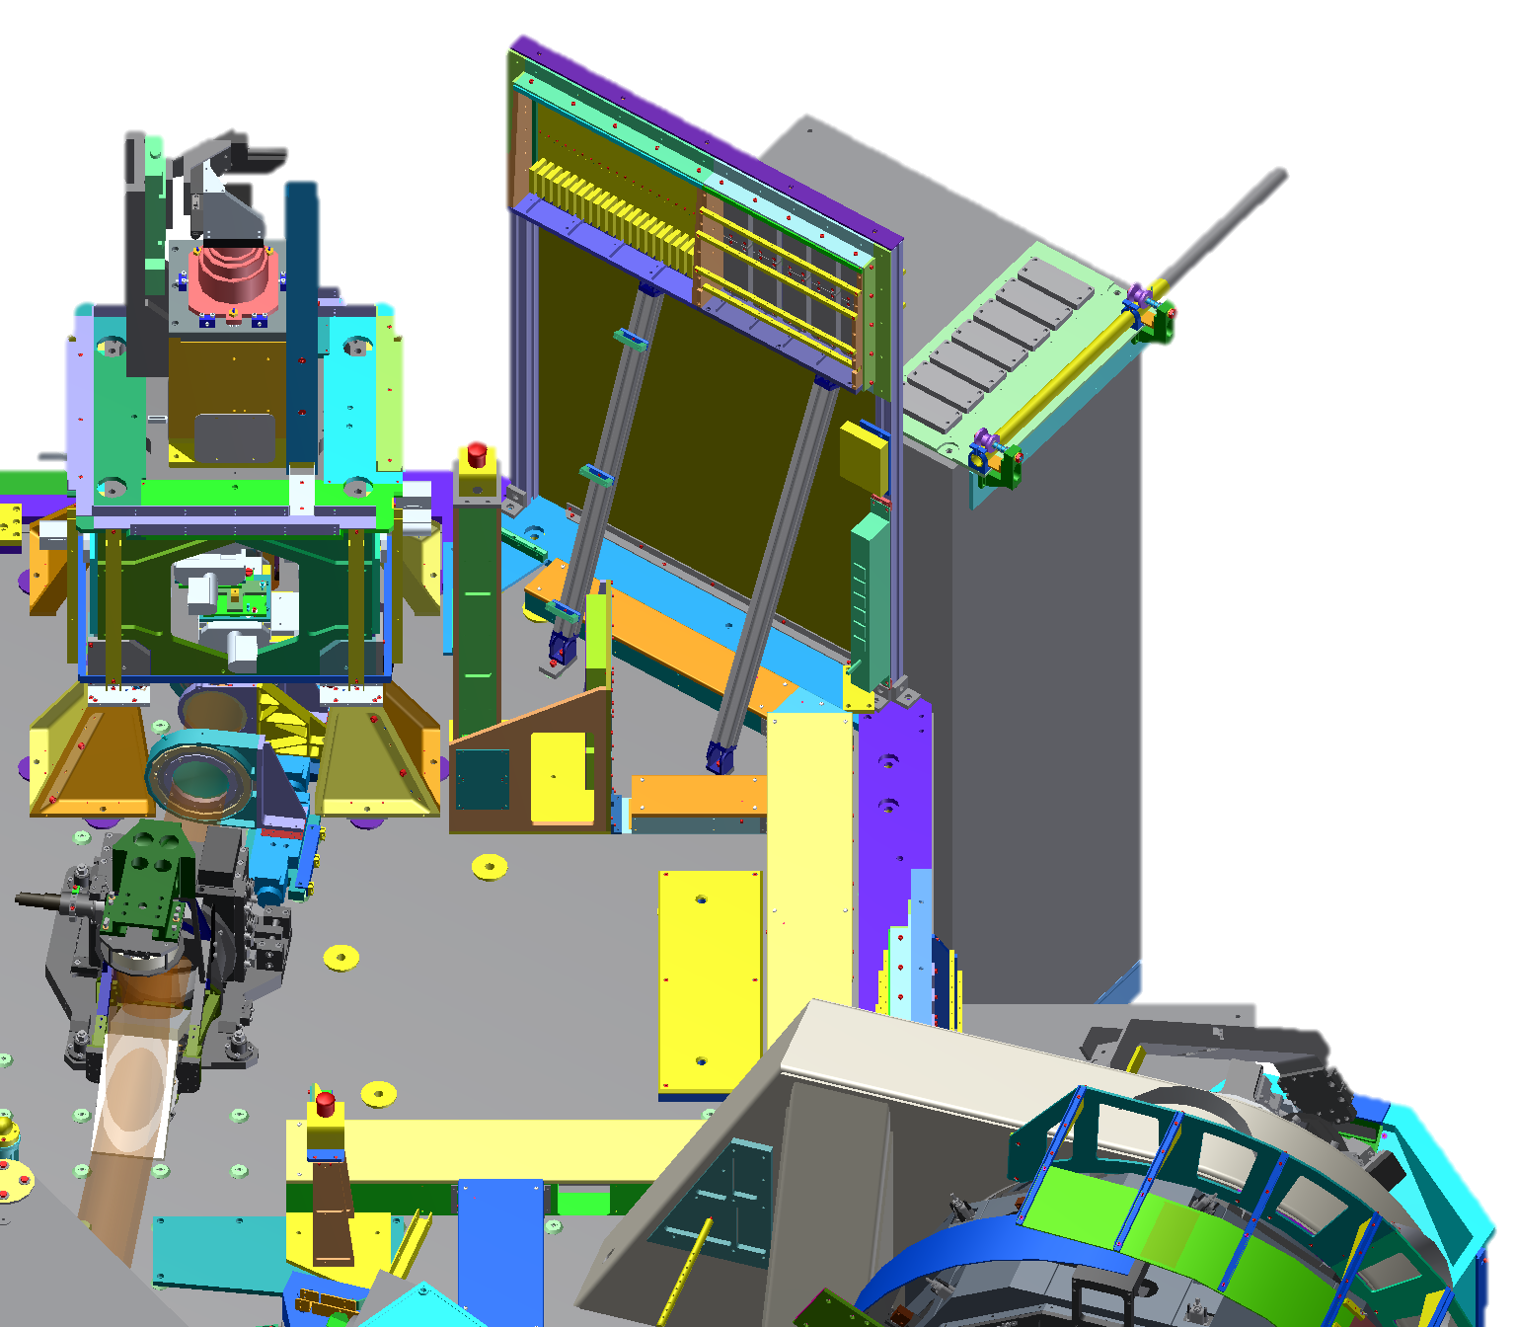
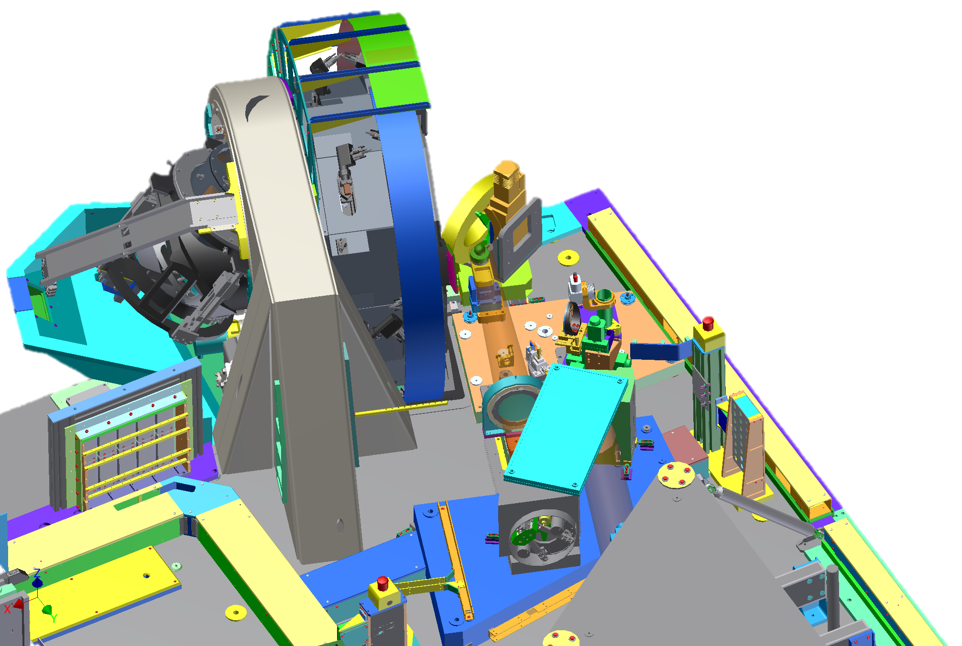
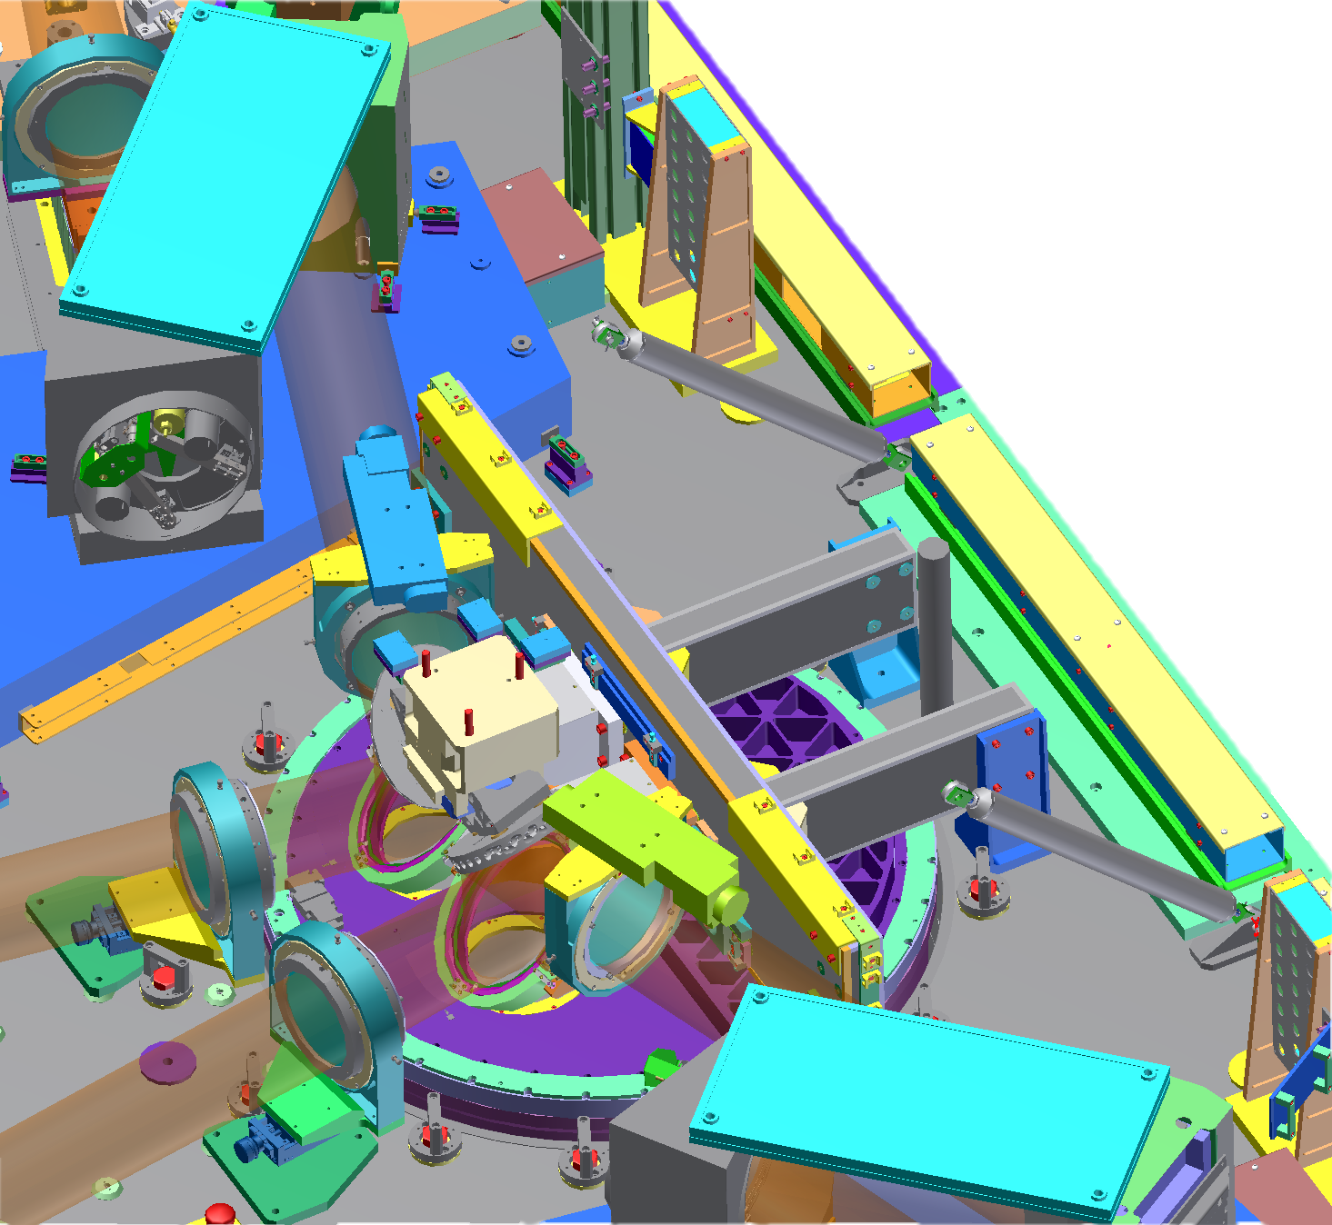
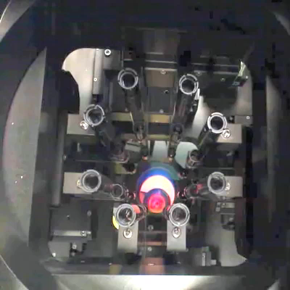
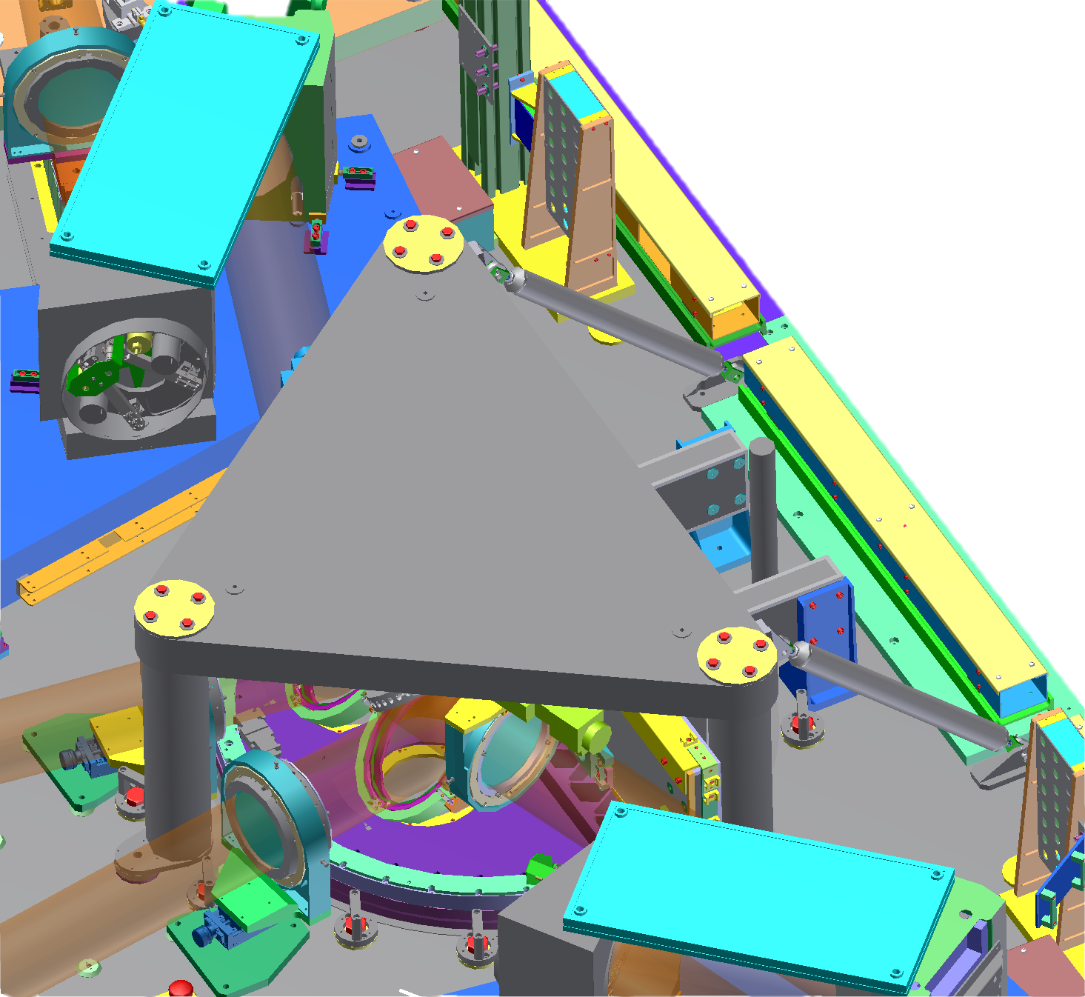
High layer Wavefront Sensor
6 arcmin FoV
Deformable mirror
Delay line/Piston mirror
Annular Mirror
Visible/NIR dichroic
K-mirror
Ground layer Wavefront Sensor
Science channel cryostat

Slide 5
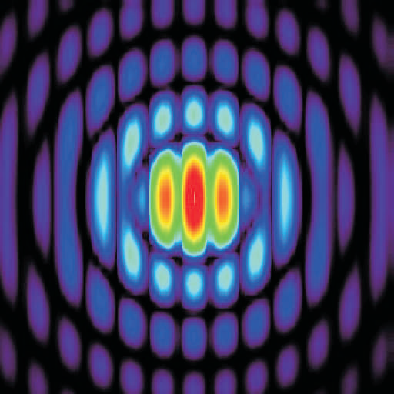
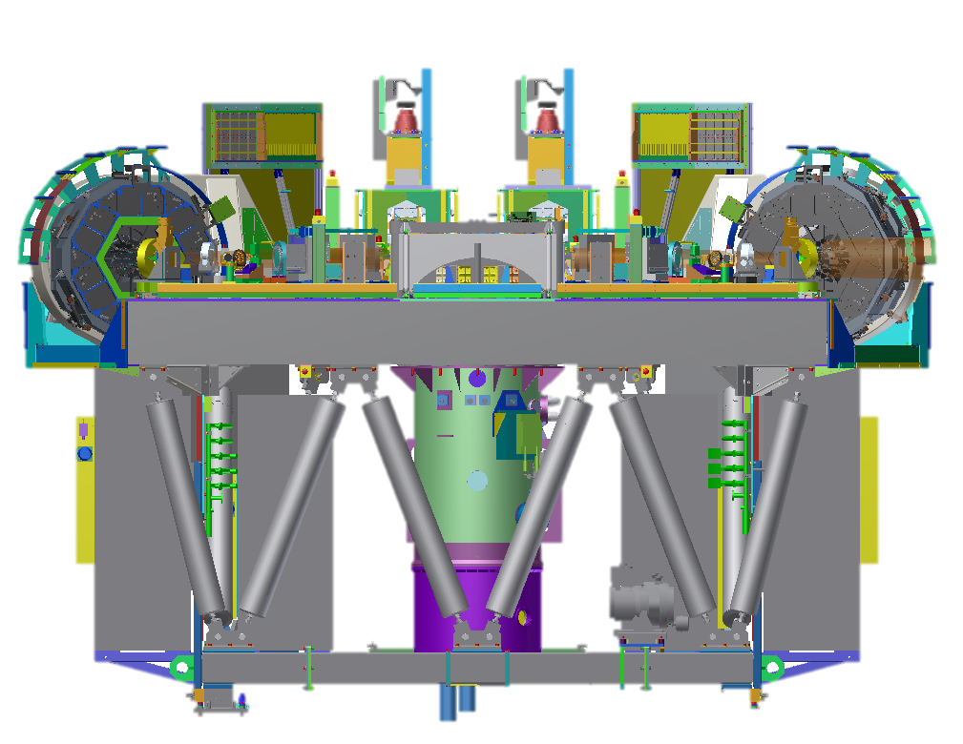

Slide 6



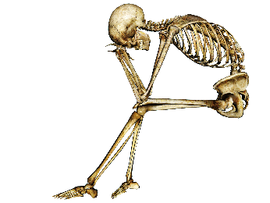
LINC-NIRVANA original plan
Yaaaawn….too easy!
Resources
Build
Implement
Science
LINC/SCAO (on-axis, self referencing interferometry)
Build
Implement
Science
Time
GLAO
Build
Implement
Science
MCAO
Build
Implement
Science
Mmmm…I knew it was going to end like this…
NIRVANA
(MCAO-fed, off-axis interferometry)

Slide 7

LINC-NIRVANA original plan
Yaaaawn….too easy!
Resources
Build
Implement
Science
LINC/SCAO (on-axis, self referencing interferometry)
Build
Implement
Science
Pathfinder
Time
GLAO
Build
Implement
Science
MCAO
Build
Implement
Science
Mmmm…I knew it was going to end like this…
NIRVANA
(MCAO-fed, off-axis interferometry)

Slide 8


Item | Value / Comment
Mode | Multi-Conjugate Adaptive Optics Near-IR imaging
Wavelength | 1.1 – 2.4 µm; broad and narrow band filters
Plate Scale | 5.11 mas per pixel
Spatial Resolution | 30 mas – J Band 41 mas – H Band (FWHM of diffraction-limited peak) 53 mas – K Band
Field of View | 10.5” (110 square arcsec)
Adaptive Optics | 2-layer, multi-conjugate with 12 NGS for GLAO and 8 NGS for high-layer AO. The deformable mirrors have 672 (ground) and 349 (high) actuators
Strehl Ratio | J-band 20% H-band 40% (based on simulations) K-band 60%
Sky coverage | Galactic plane 99% North Galactic Pole 48%
Lean MCAO

Slide 9
After commissioning LINC-NIRVANA will support:
    «campaign mode» JHK interferometry.
    Natural guide stars MCAO in a 10 x 10 arcsec FoV.
What we want:
    Largest possible FoV (41 or 82 arcsec).
Proposed Upgrade

Slide 10
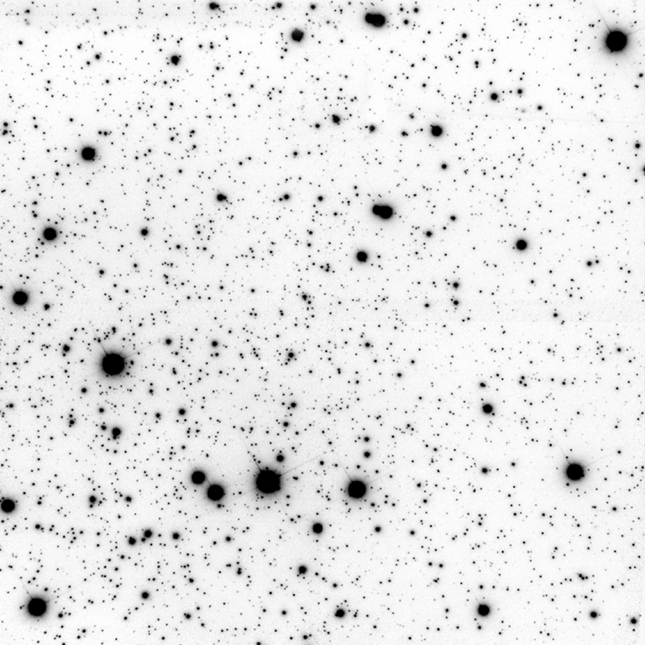
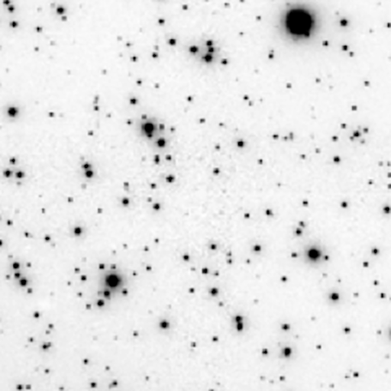
41” Upgrade
Now
10.5”
41”
Courtesy of Tom Herbst
Gemini -GeMS First Light

Slide 11
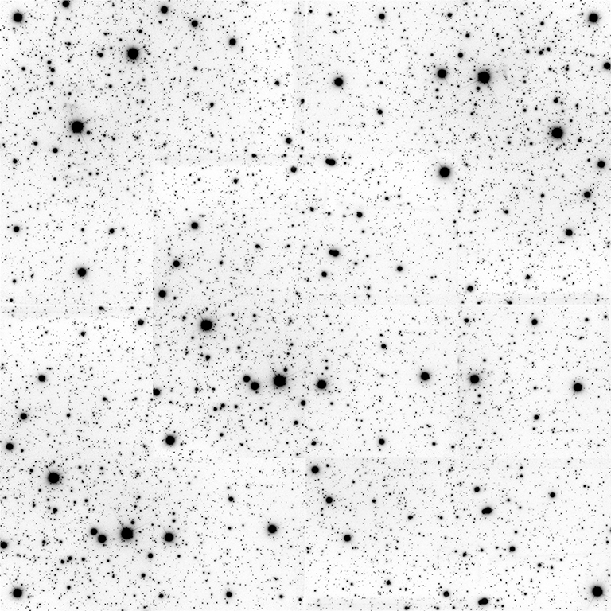
41” Upgrade
82” Upgrade
82”
Courtesy of Tom Herbst

Slide 12
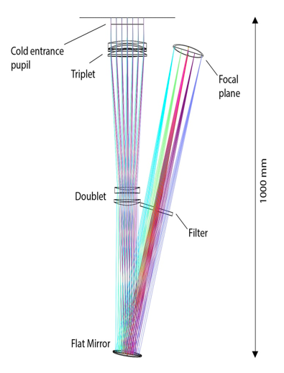
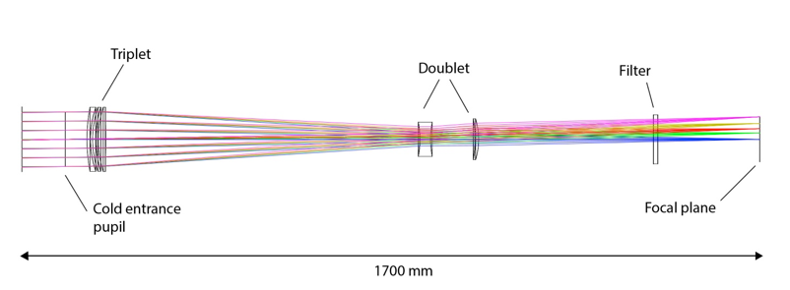
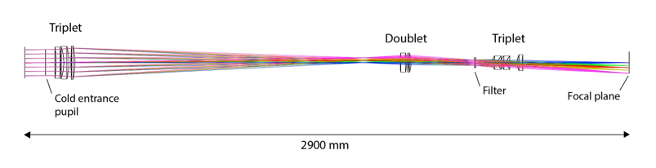
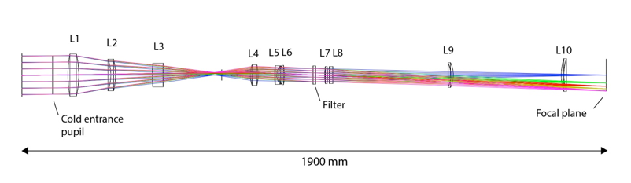
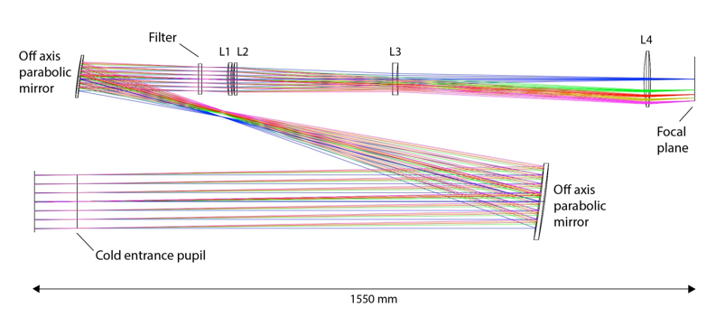
Preliminary Work…
(D. Greggio & P. Bizenberger)
All designs:
  Are diffraction limited 1 – 2.5 μm.
  Cost ca. 500 k€.
  Fit within existing cryostat.

Slide 13
Item | Value / Comment
Mode | Multi-Conjugate Adaptive Optics Near-IR imaging
Wavelength | 1.1 – 2.4 µm; broad and narrow band filters
Plate Scale | 5.11 mas per pixel (20 mas/pixel)
Spatial Resolution | 30 mas – J Band 41 mas – H Band (FWHM of diffraction-limited peak) 53 mas – K Band
Field of View | 10.5” (110 square arcsec) (Wide field optics give 41’’ square with a 2k detector and 82’’ square with a 82’’ detector).
Adaptive Optics | 2-layer, multi-conjugate with 12 NGS for GLAO and 8 NGS for high-layer AO. The deformable mirrors have 672 (ground) and 349 (high) actuators
Strehl Ratio | J-band 20% H-band 40% (based on simulations) K-band 60%
Sky coverage | Galactic plane 99% North Galactic Pole 48%
Lean MCAO
Upgrade

Slide 14
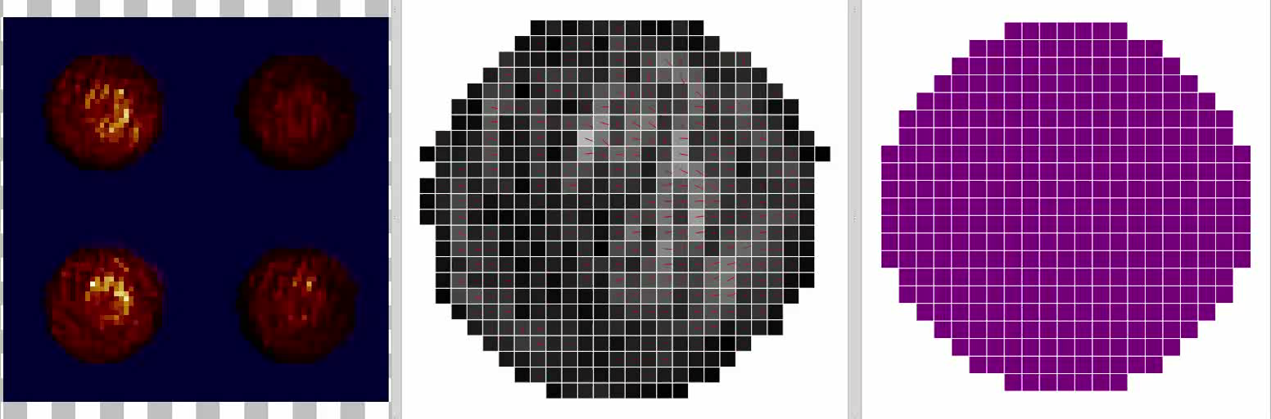
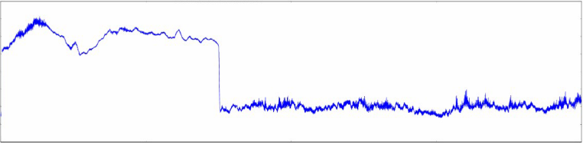
450
400
350
300
Residual WF RMS Error (nm)
250
200
150
100
50
0
5
10
Time (s)
15
20
25

Slide 15
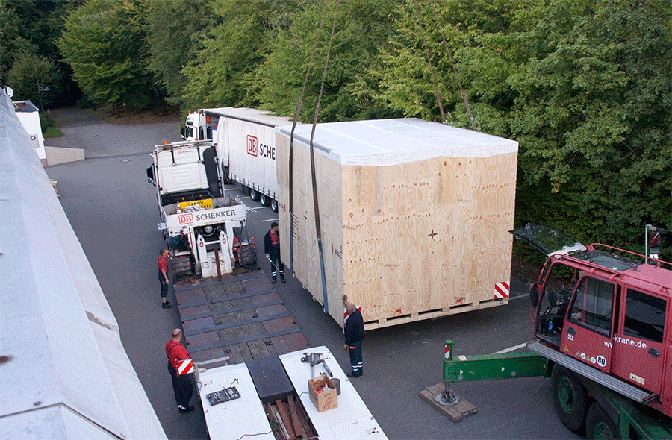
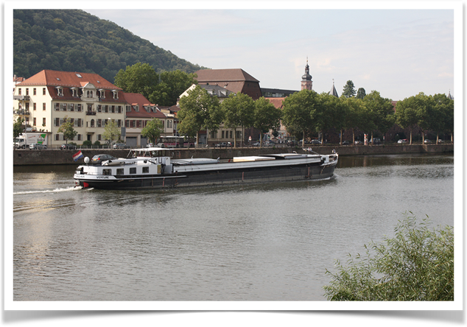
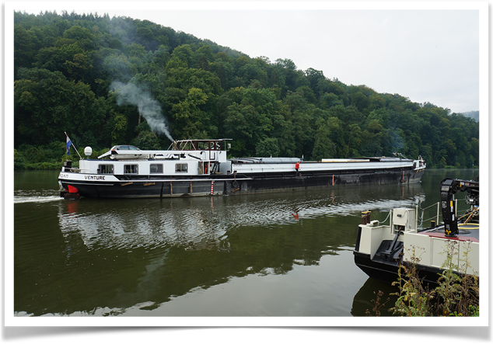
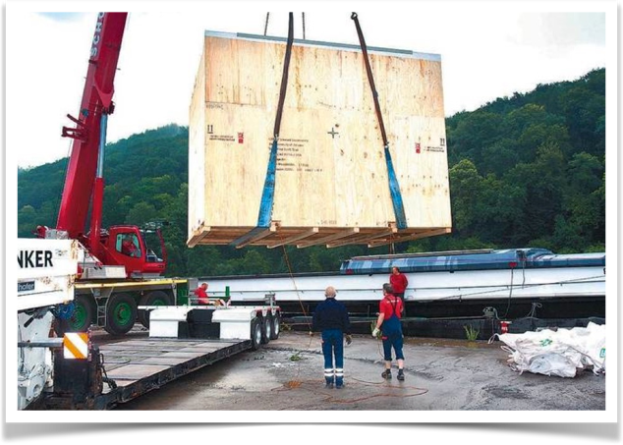
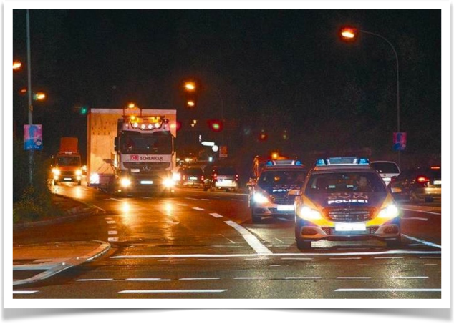
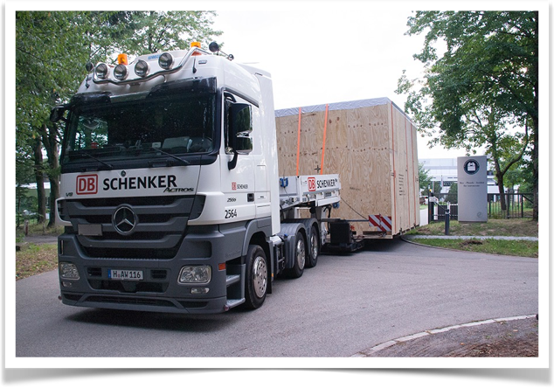
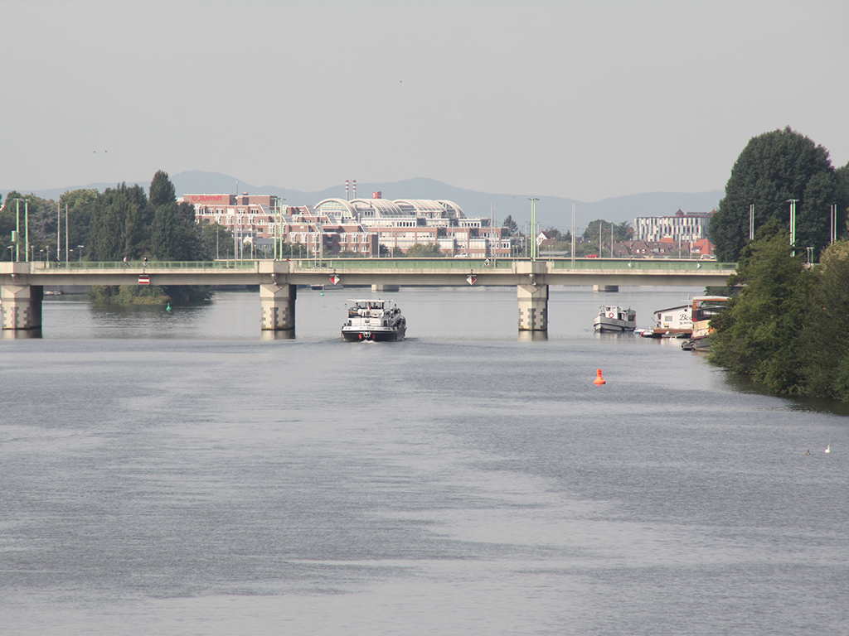
Departure | Arrival | Mode of transport | Distance [km] | Time [d]
MPIA | Neckarsteinach | Lowboy Trailer | 18 | <1
Neckarsteinach | Bremerhaven | Riverboat | 700 | 7
Bremerhaven | Los Angeles | Cargo ship | 15120 | 23
Los Angeles | LBT basecamp | Lowboy Trailer | 970 | 2
LBT basecamp | LBT summit | Lowboy Trailer | 45 | <1
TOTAL |  |  | 16850 | 50

Slide 16
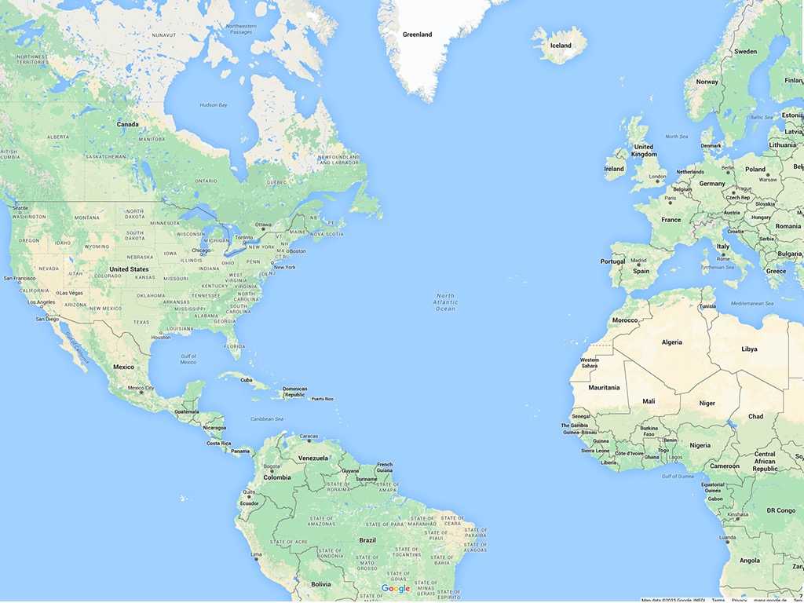
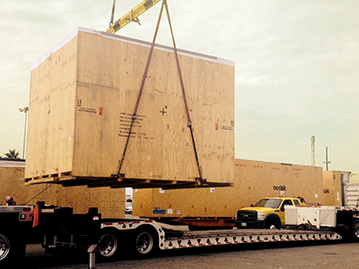
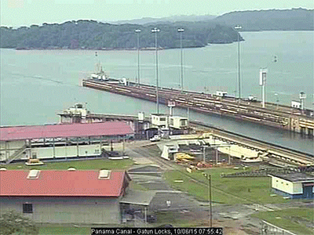
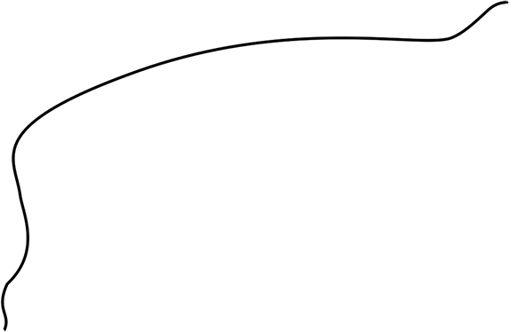


Slide 17
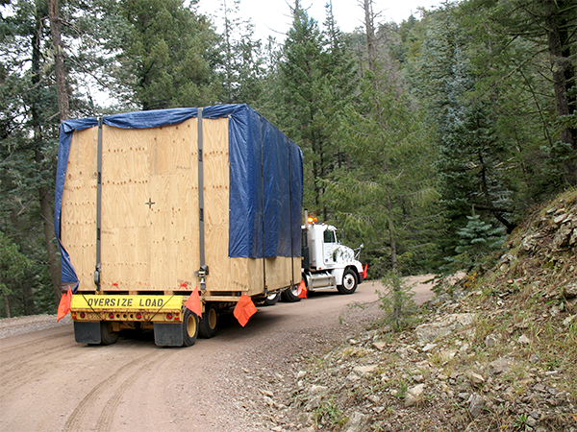
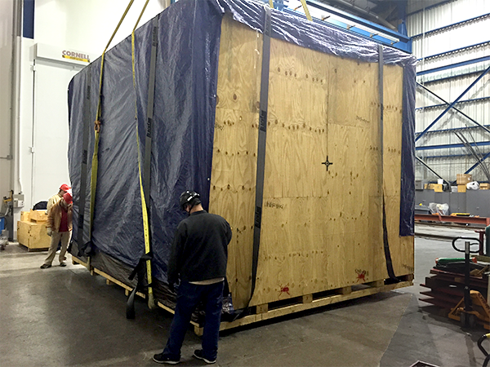
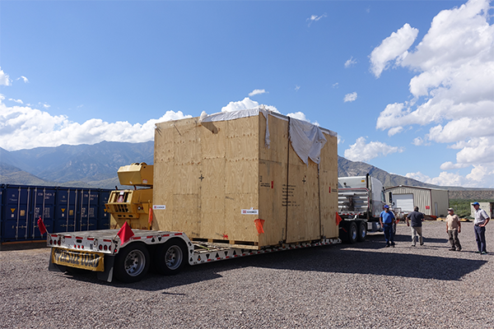
Departure | Arrival | Mode of transport | Distance [km] | Time [d]
MPIA | Neckarsteinach | Lowboy Trailer | 18 | <1
Neckarsteinach | Bremerhaven | Riverboat | 700 | 7
Bremerhaven | Los Angeles | Cargo ship | 15120 | 23
Los Angeles | LBT basecamp | Lowboy Trailer | 970 | 2
LBT basecamp | LBT summit | Lowboy Trailer | 45 | <1
TOTAL |  |  | 16850 | 50

Slide 18
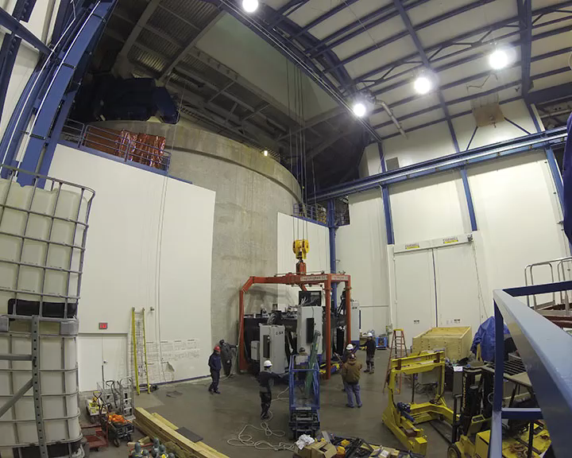
LINC-NIRVANA re-integration plan
Run | Period | Comments
I1 | 11 – 17 June 2015 | Dismantiling of Pathfinder
I2 | 09 – 25 November 2015 | Receipt & bench installation
I3 | 12 – 28 January 2016 | GWSs internal alignment
I4 | 23 – 04 Feb/March 2016 | Bench & cryostat integration
I5 | 01 – 16 March 2016 | Warm Optics alignment (both sides)
I6 | 12 – 26 April 2016 | HWSs internal alignment & loop
I7 | 04 – 11 May 2016 | Annular mirrors alignment
I8 | 26 – 09 May/June 2016 | Close loop with WFSs in lab
I9 | 10 – 21 June 2016 | Cryostat + Instrument verification
I10 | 20 – 02 Sept/Oct 2016 | Installation at instrument platform
We are here

Slide 19
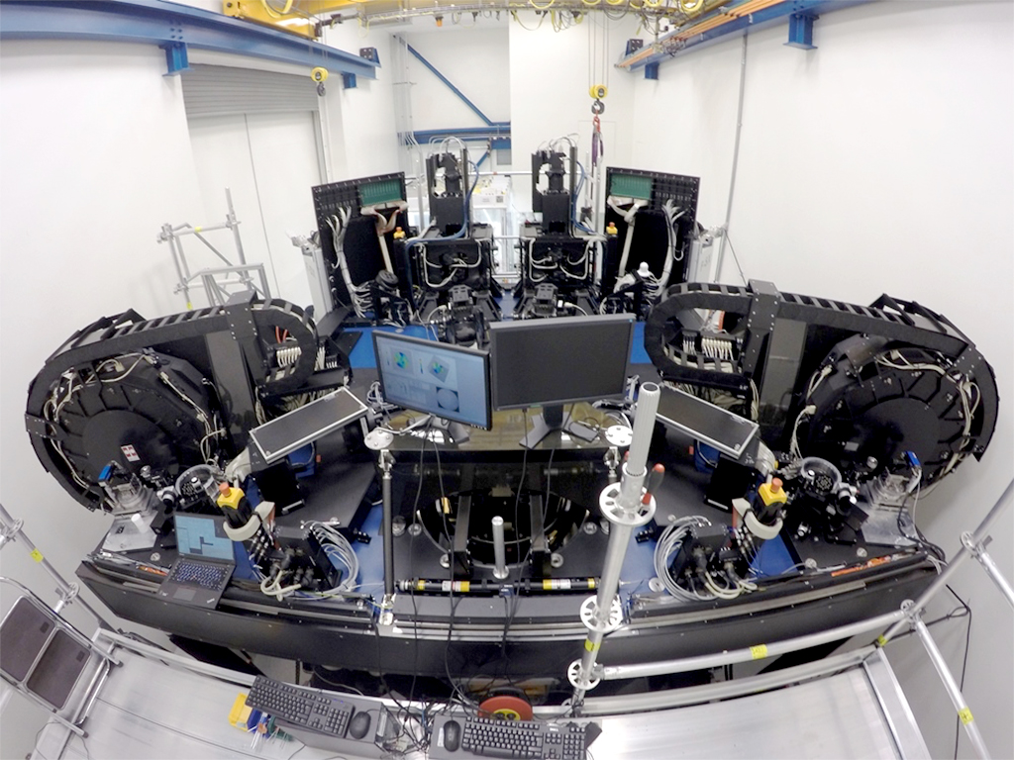

Slide 20
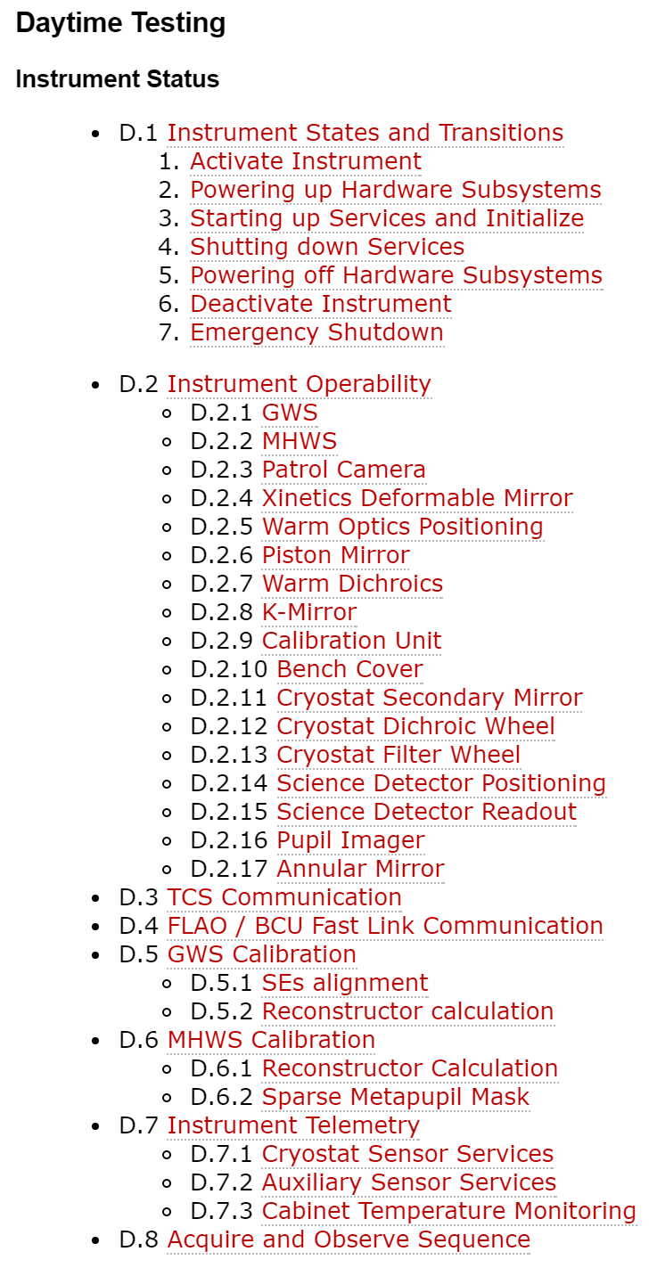
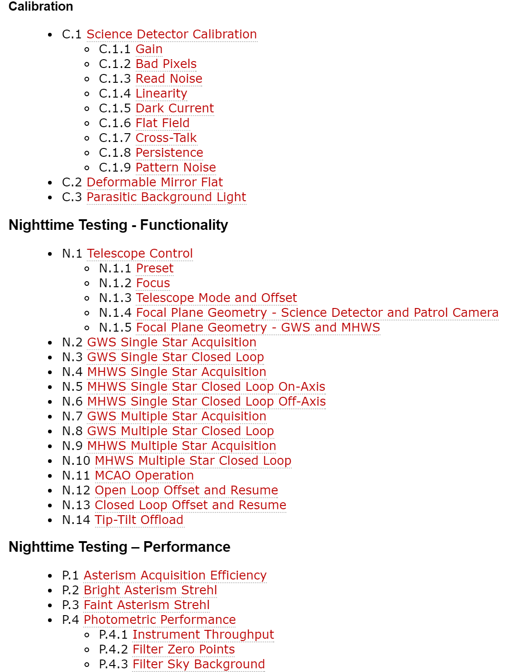
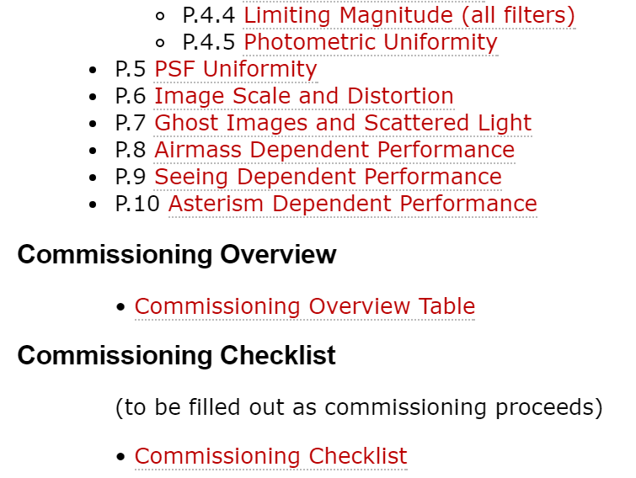
What next?
Conclude internal re-alignment of the instrument.
Align LINC-NIRVANA to the telescope.
Commissioning.
Camera upgrade?
Interferometry?

