Slide 1
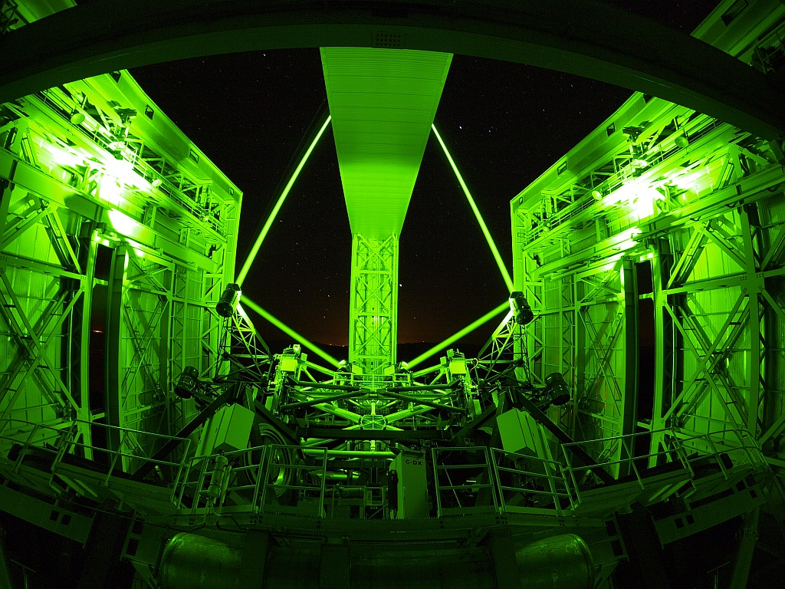









Science operations with ARGOS, the ground layer adaptive optics facility of LBT
Lorenzo Busoni on behalf of the ARGOS consortium
ADONI workshop – Firenze 12 april 2016

Slide 2
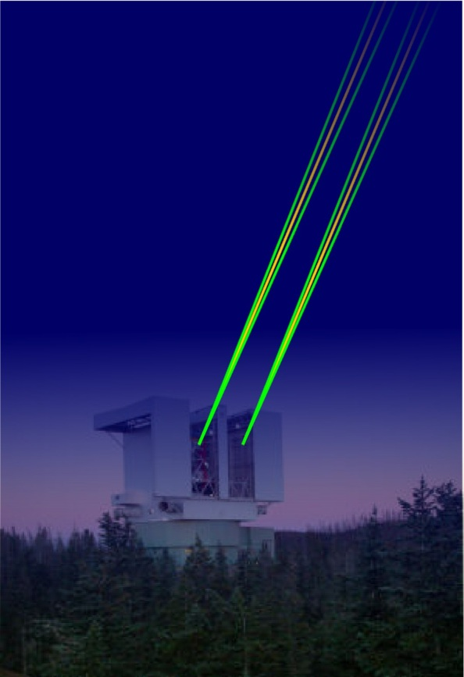
A Ground layer AO system for the 2 NIR spectrographs LUCI
3-lasers star constellation per eye
High power green Rayleigh beacons at 12km
Gated SH wavefront sensors
Uses FLAO‘s adaptive secondary as corrector
Uses FLAO‘s pyramid WFS for NGS sensing
Begin 2008, commissioning 2013+, 8 Meuro
INAF/Arcetri responsible of Laser WFS units

Slide 3
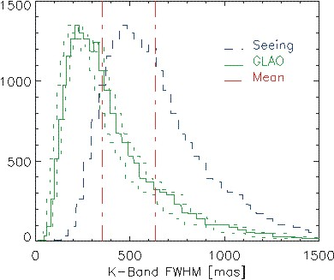
ARGOS simulated performance
‘Make a good night excellent’
Simulations based on LBT turbulence statistics for the LUCI instrument
A factor 2-3 in FWHM can be gained over the full 4x4‘ LUCI FoV
A factor 2-3 more flux is gained in a 0.25‘‘ slit.
‘The high resolution project nights’
‘Make a bad night acceptable’
ARGOS acts as a seeing enhancer

Slide 4
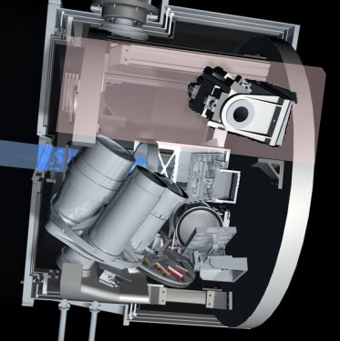
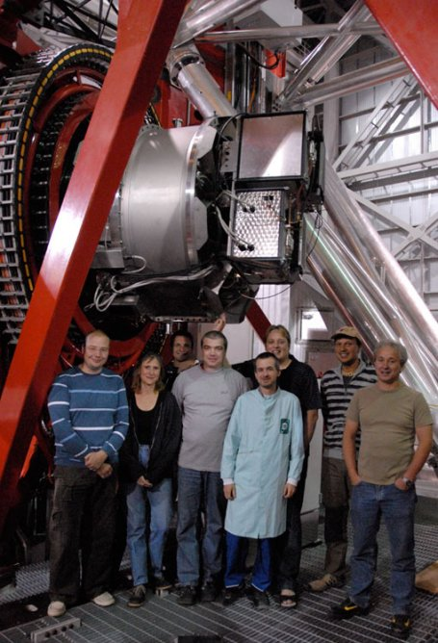
LUCI, the NIR Camera at LBT
MOS unit
gratings
Multi Object Spectrograph and Imager
Longslit or MO spectroscopy
1-2.5um wavelength range
Adaptable scale/ FoV
Different operating modes: seeing limited, enhanced seeing, diffraction limited.
camera wheel
filter wheel
Mode | Parameter | Imaging | Spectrosc.
Enhanced seeing | FoV | 4x4’ | 4x2’
 | Scale | 0.12’’/px | 0.12’’/slit
 | Resolution |  | 3800-17000
Diffraction limited | FoV | 30x30’’ | 30x30’’
 | Scale | 0.015’’/px | 0.015’’/slit
 | Resolution |  | 10000-40000
ARGOS
FLAO

Slide 5
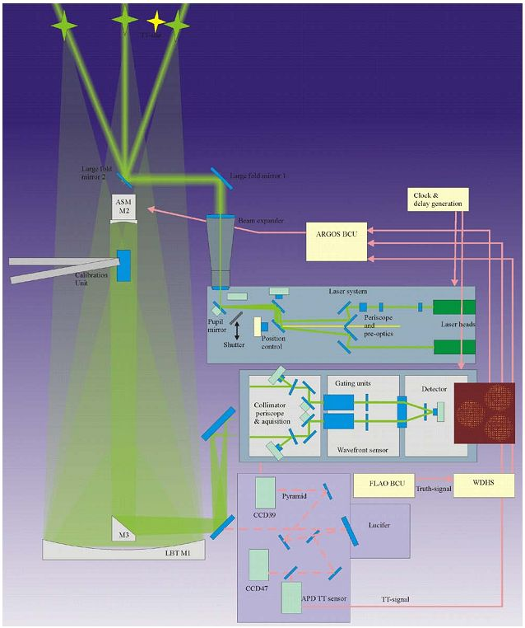
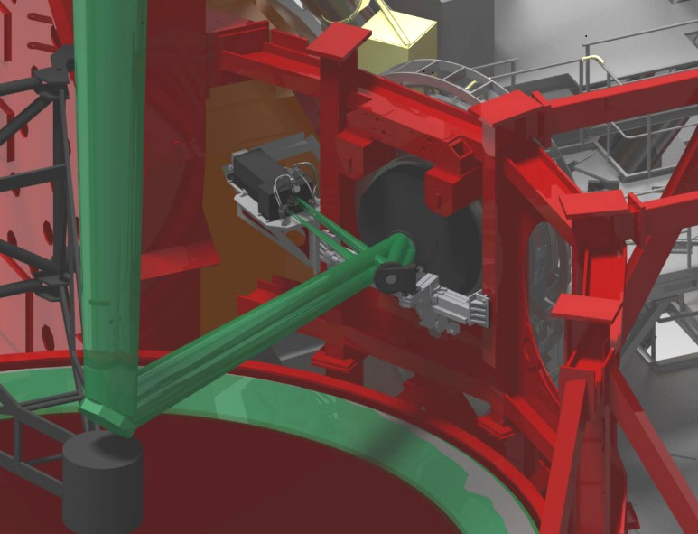
ARGOS in a nutshell
The main ARGOS components are:
Laser System: generate laser, adjust asterism for on-sky: 3x15W lasers at 2’off-axis @ 12km altitude.
Launch Optics: expands and focuses laser beams
The Adaptive Secondary Mirror is used as DM
Beam splitter optics: deviate laser light towards LGS WFS, transmits VIS and IR toward NGS WFSs and LUCI
LGS WFS: 3 SH 15x15 subaps on a single detector
NGS TT and Reference (truth) sensor on Pyramid FLAO board
2arcmin
12km
2
3
1
5
4
6
Notes:
ARGOS started in 2006 and it is now in its commissioning phase at the telescope
It is a quite complex system expecially in terms of control loops.
Briefly we have a laser system where are installed 3 commerlacial 18W lasers heads for each telescope eye
Then we have some large optics that expands and fold the laser beams behind the Secondary mirorr from where they propagated into the atmosphere
The 3 laser beams for each eye are focussed at 12km distance where they produce a triangular asterism of artificial guide stars 2arcminutes offaxis.
On the downward path the light is collected by the telescope optics and it is splitted from the science radiation by a dichroic beam splitter just in front of the instrument rotator.
In the end the laser light enters the LGS wavefront sensor.
Arcetri is responsible for providing the 2 laser guide start wavefront sensor units and the beam splitter optics.

Slide 6
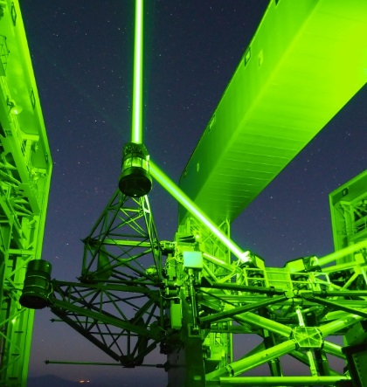
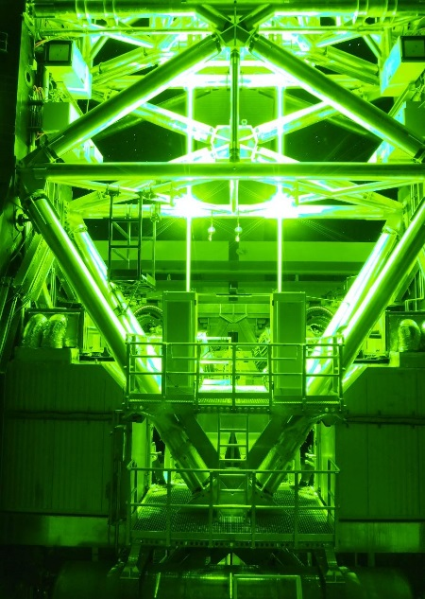
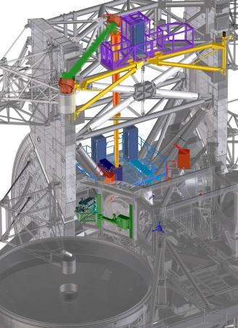
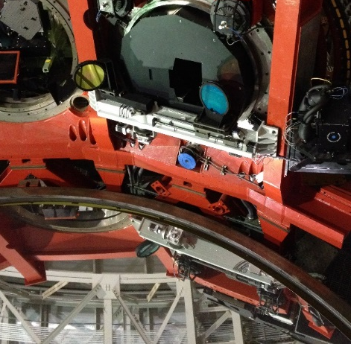
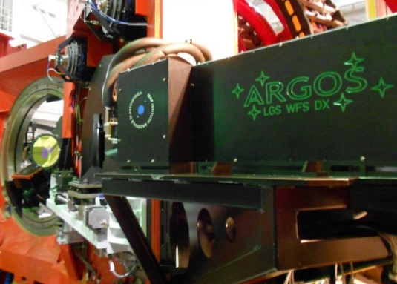
ARGOS at LBT
Laser system
Launch mirrors
LGS WFS (Arcetri)
LGS dichroic (Arcetri)

Slide 7
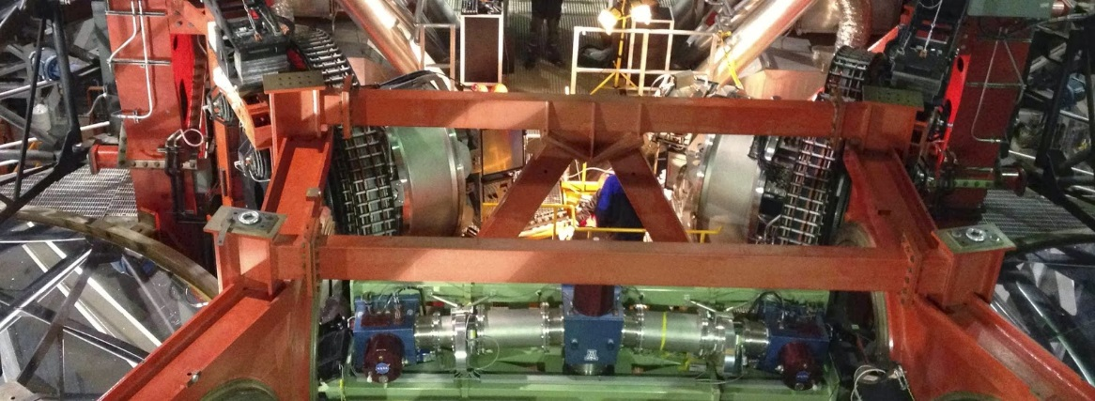
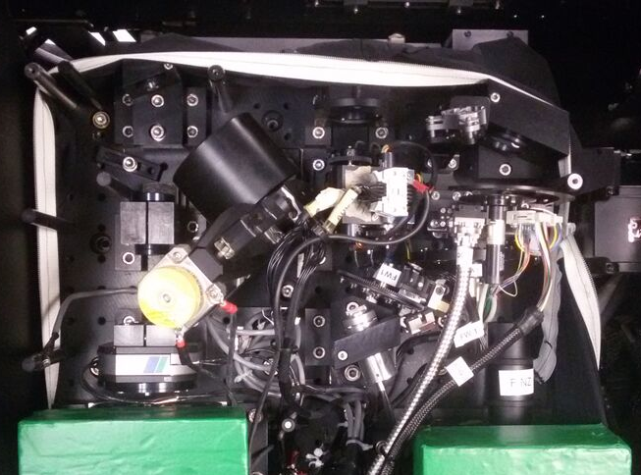
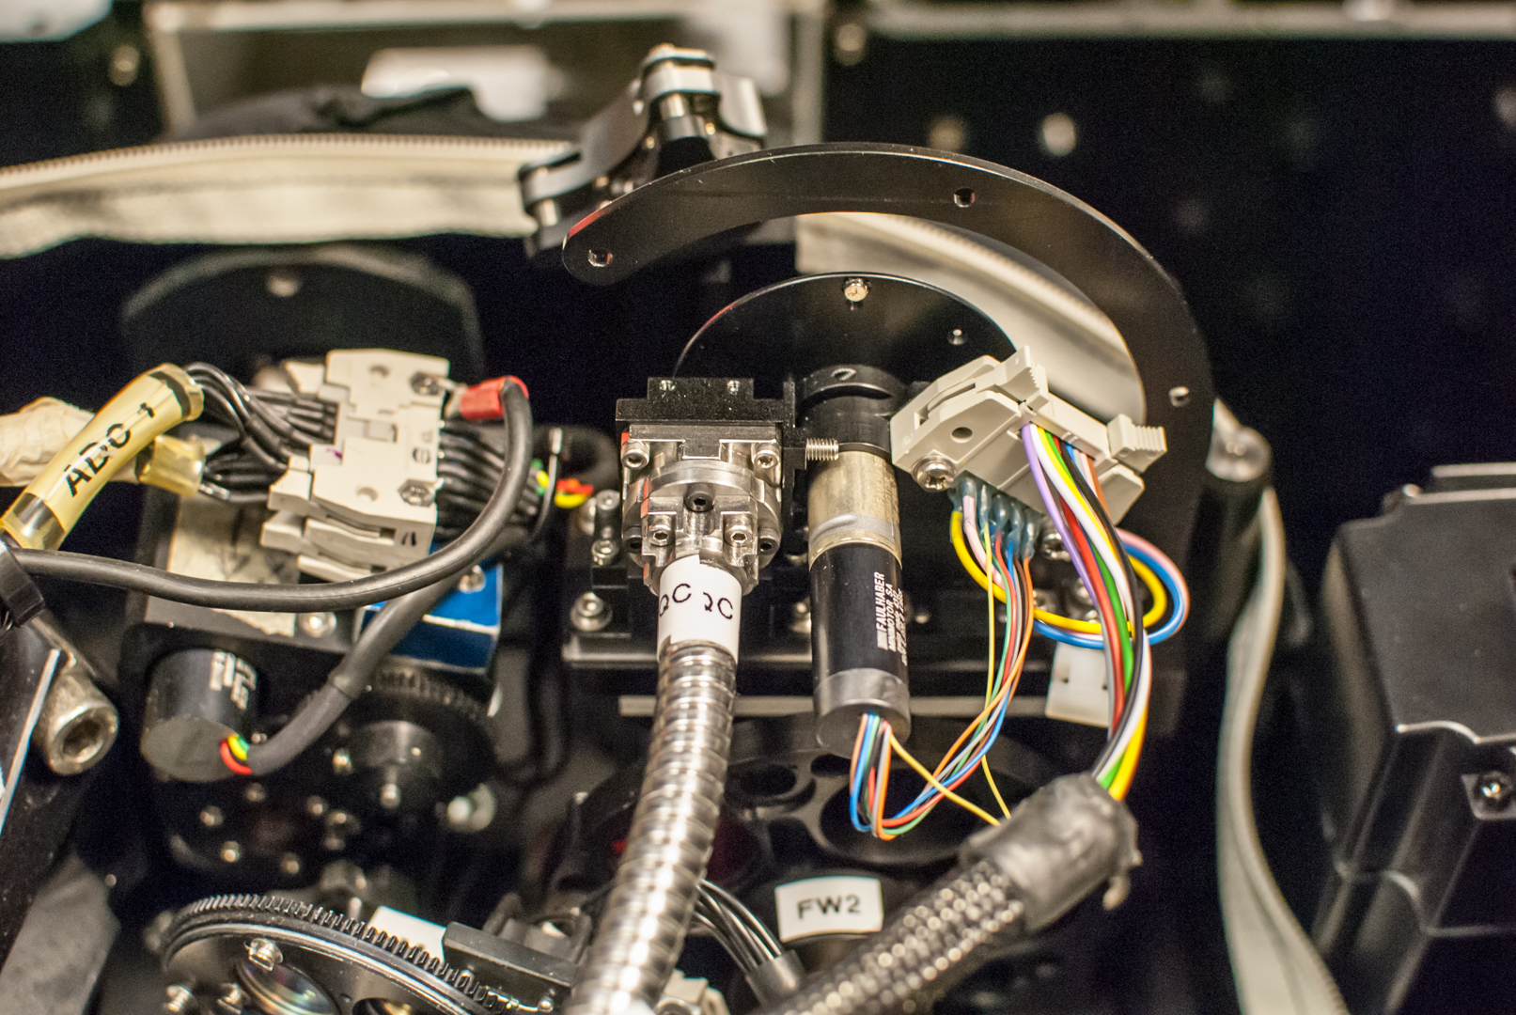
ARGOS at LBT
LUCI NIR imager and MOS
90% NGS: Tip-tilt sensor (quad-cell)
10% NGS: Truth sensor (Pyramid)
APD TipTilt sensor

Slide 8
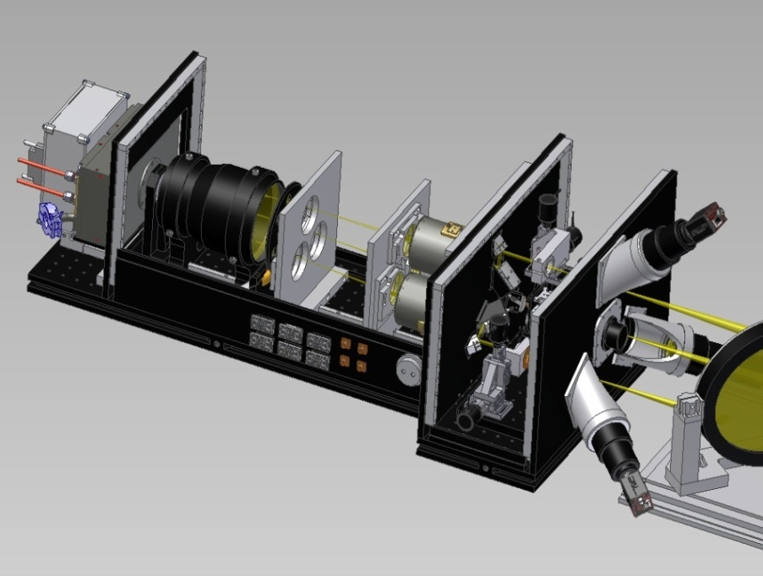
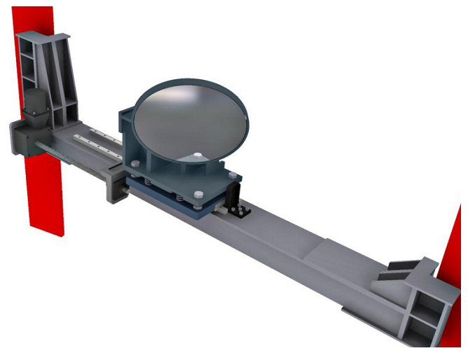
INAF-Arcetri in ARGOS
Dichroic and LGS WFS design, integration and test
10 FTE in 3 years
1.2MEuro (HW+FTE)
1.7m
3 laser beams combined on a single detector
15x15 subaps @ 1kHz, pupil and jitter actively compensated, acquisition cameras 1’ FoV, Pockels cells to gate @ 12km
Dichroic unit deployed to split laser beams from red & NIR

Slide 9
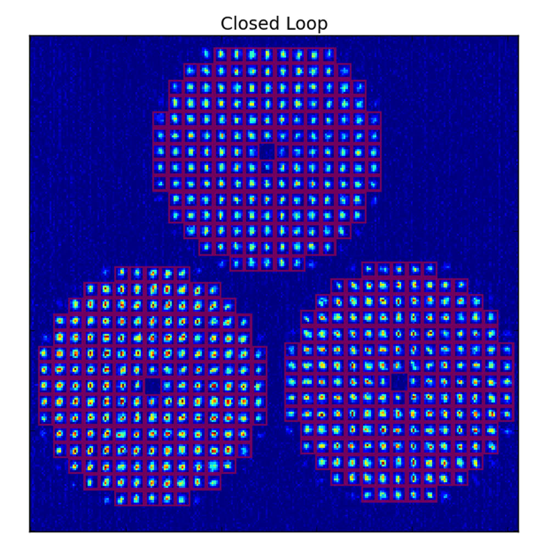
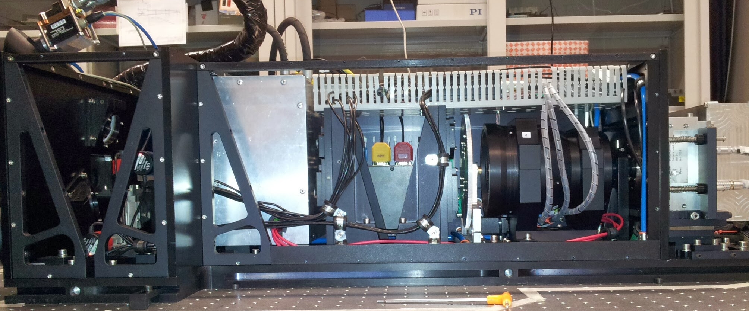
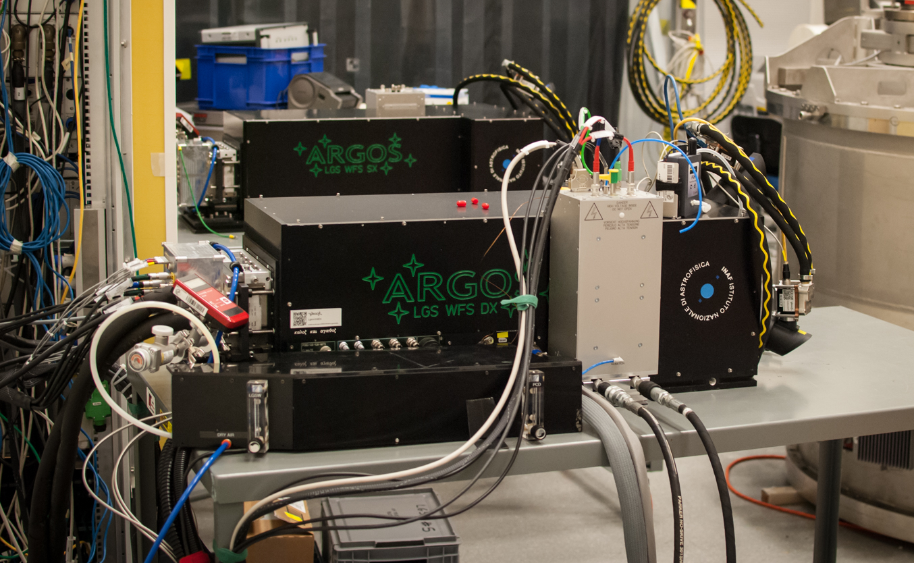
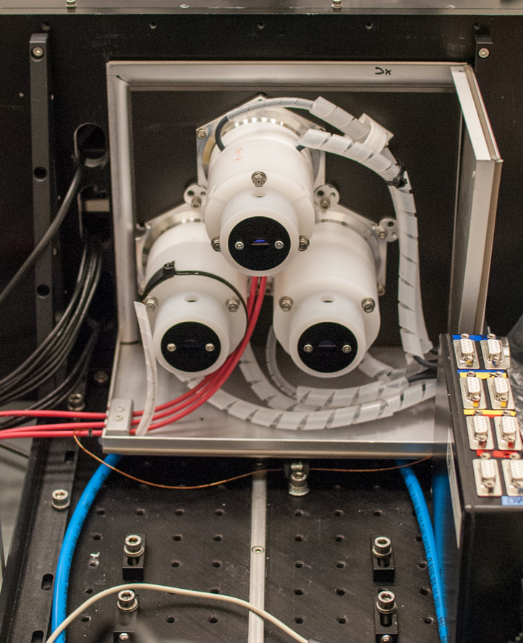
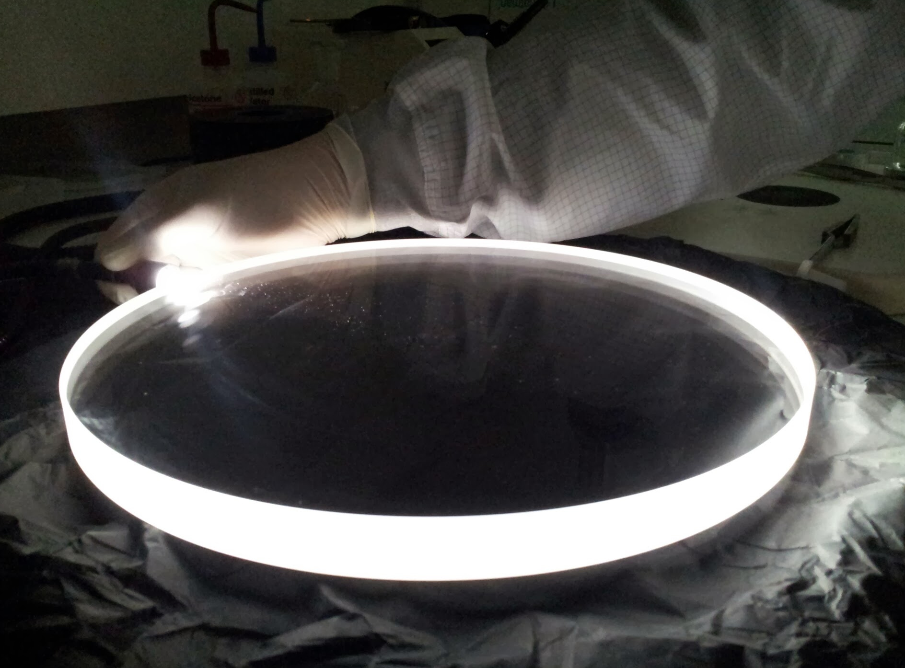
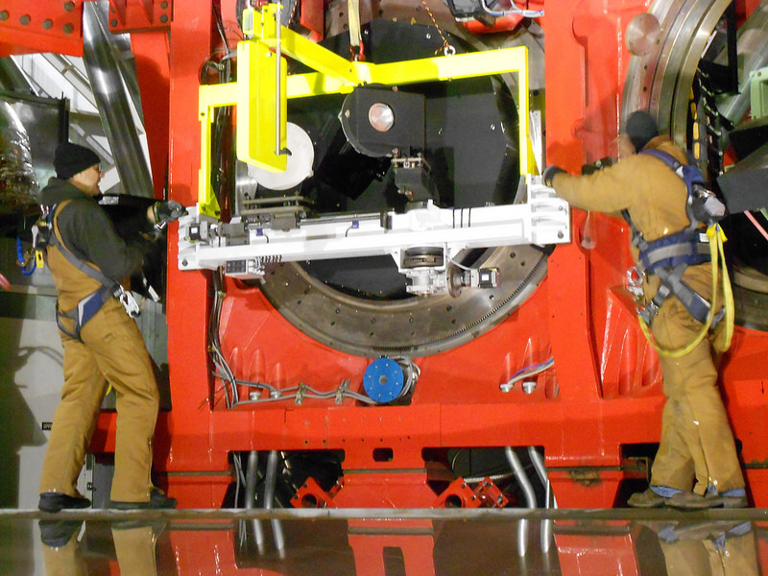

Slide 10
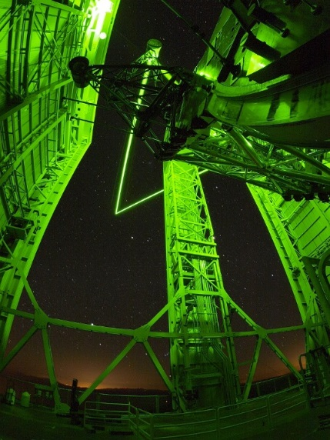
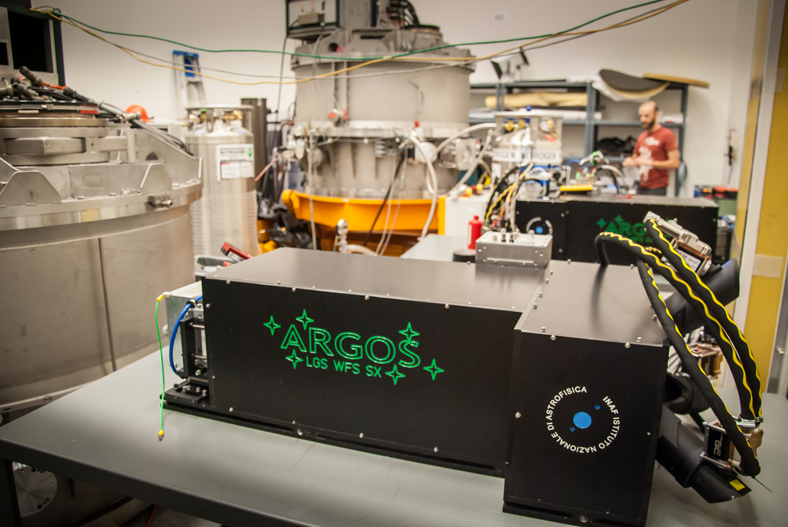
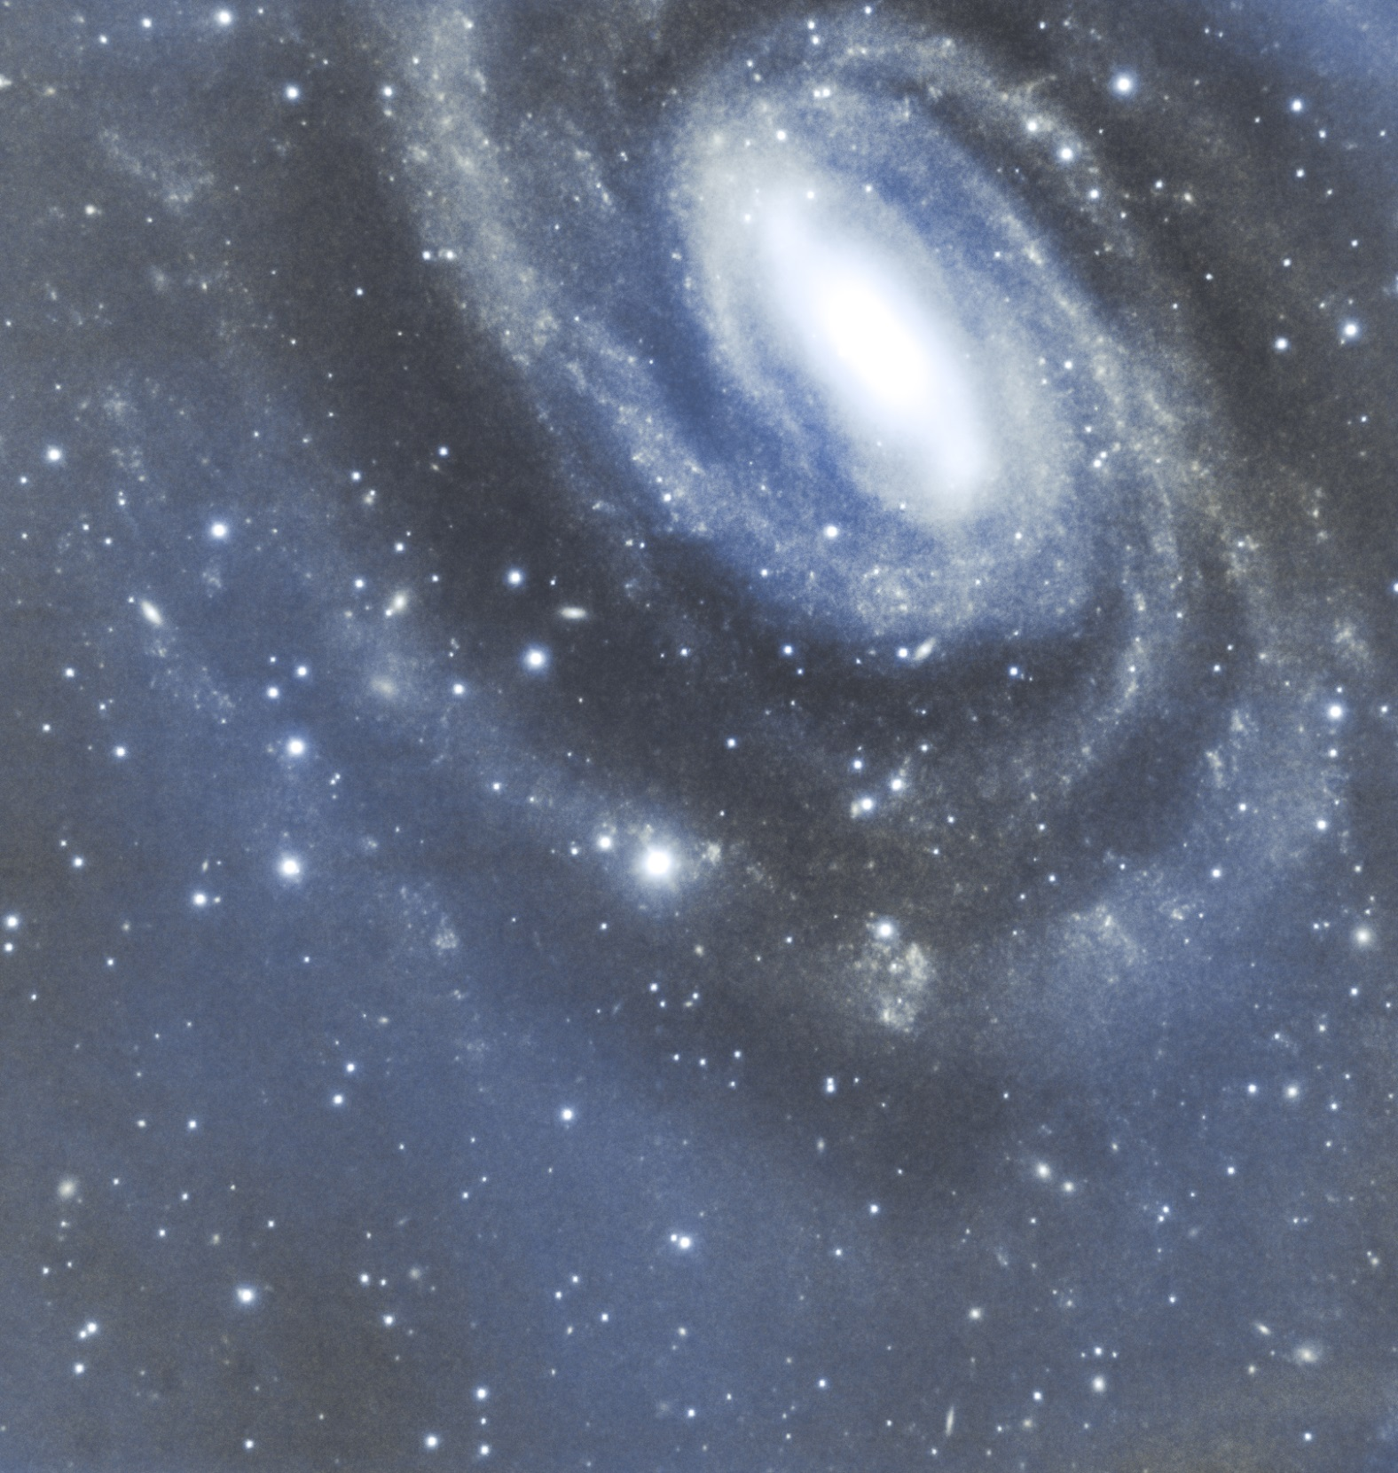
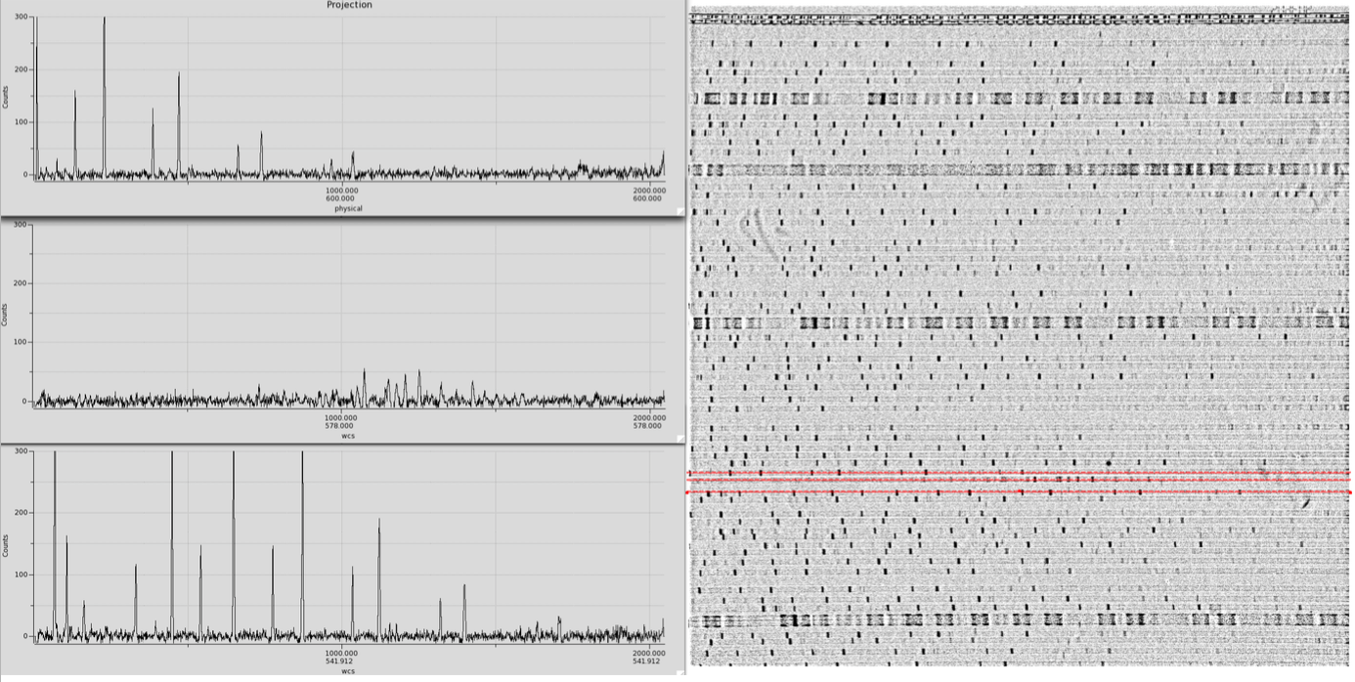
ARGOS Timeline
Phase A study
PDR
FDR
First ARGOS steel and infrastructure
Laser system installed
2013 Nov First light of LAS
May LGS WFS first light (DX side)
2014 Dec First GLAO closed loop (complete DX) + LUCI2
2015 Dec First GLAO closed loop (complete SX) + LUCI1
2016 Mar LUCI1 GLAO MOS spectra
~170 work days on summit
47 nights allocated to ARGOS
252h of open dome (~25 nights = 54%)
18 AO nights (= 72%)

Slide 11
NGC6384 nearby galaxy at ~20Mpc (extending over several arcmin)
May 2015
Testing & learning:
Long exposure stability
Dithering sequence
H-band: ~30min
J-band : ~30min
Notes:
Exquisite data in
Different bands
Different AO modes: ARGOS, NGS, hybrid
Experimenting with the dithering and software automatization

Slide 12
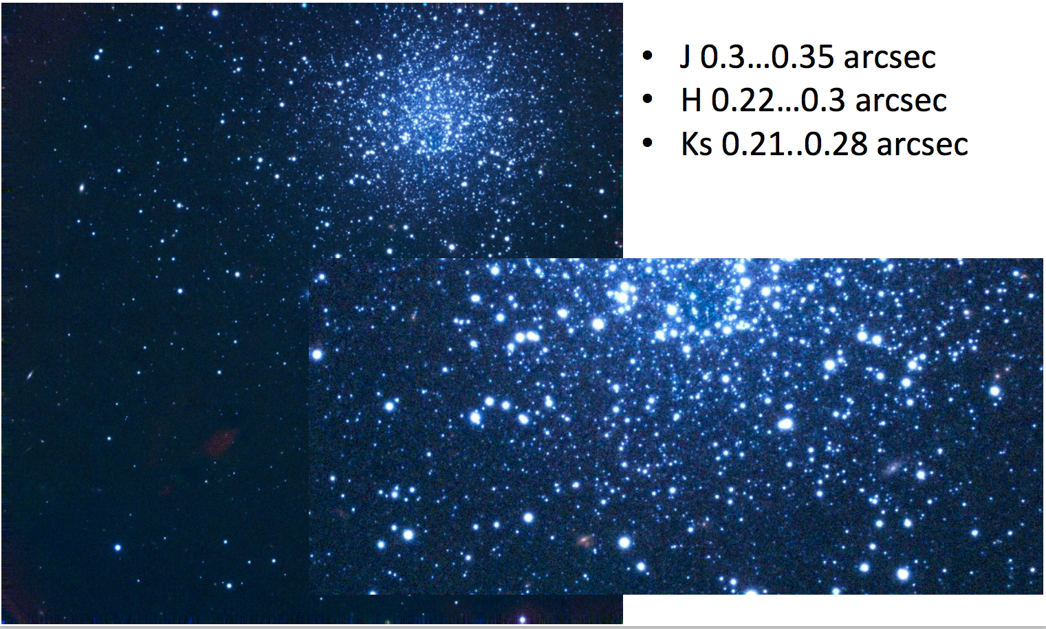
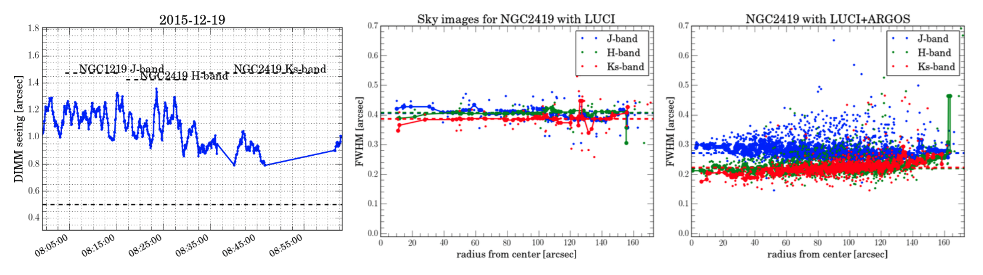
NGC2419 – Correction Uniformity
Courtesy of Gilles Orban de Xivry

Slide 13
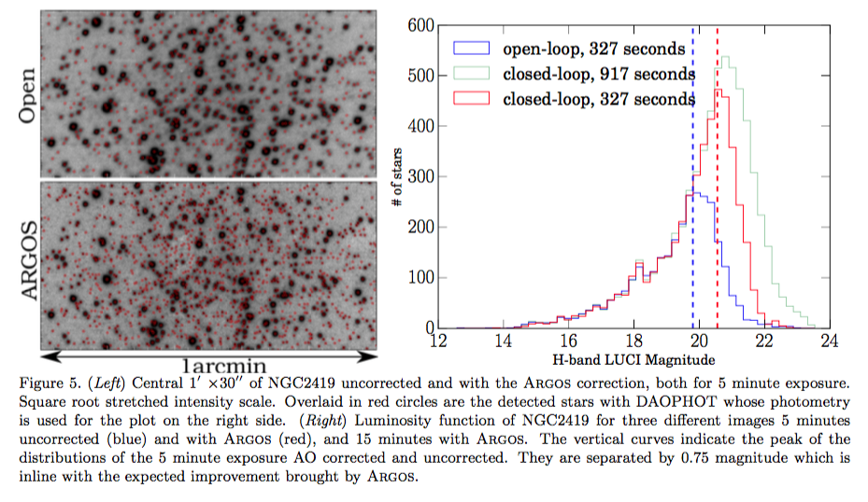
NGC2419 - Point source sensitivity
S/N improvement of factor 2 (0.75mag) equivalent to integration time reduction of factor 4
Courtesy of Gilles Orban de Xivry

Slide 14
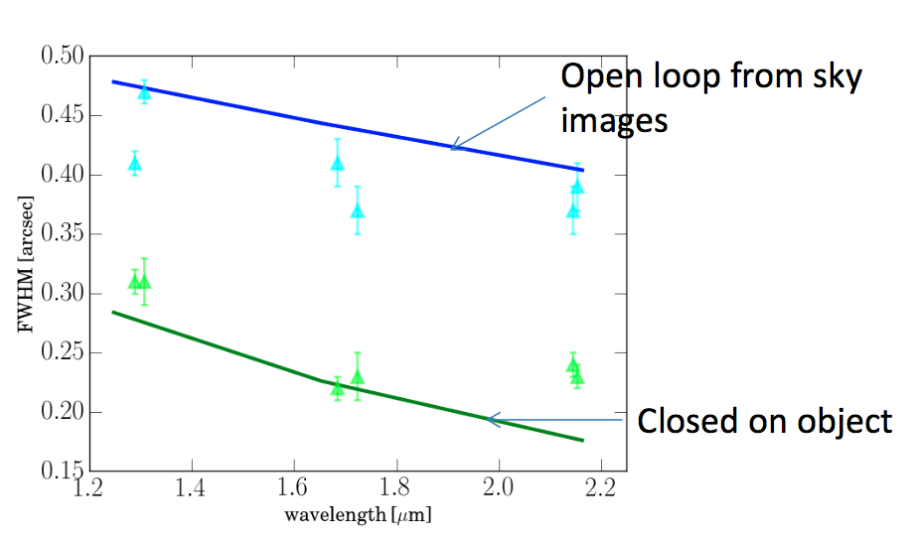
Statistic of performances – March 2016
Nyquist sampling
Solid lines = simulation for 0.8” seeing
Courtesy of Gilles Orban de Xivry

Slide 15
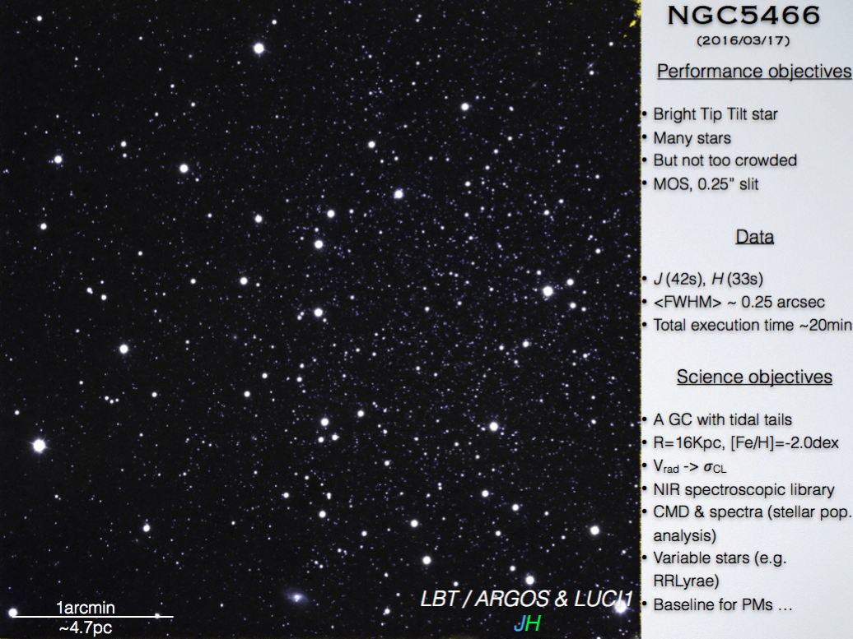
First LGS-AO MOS observation
Courtesy of Iskren Georgiev

Slide 16
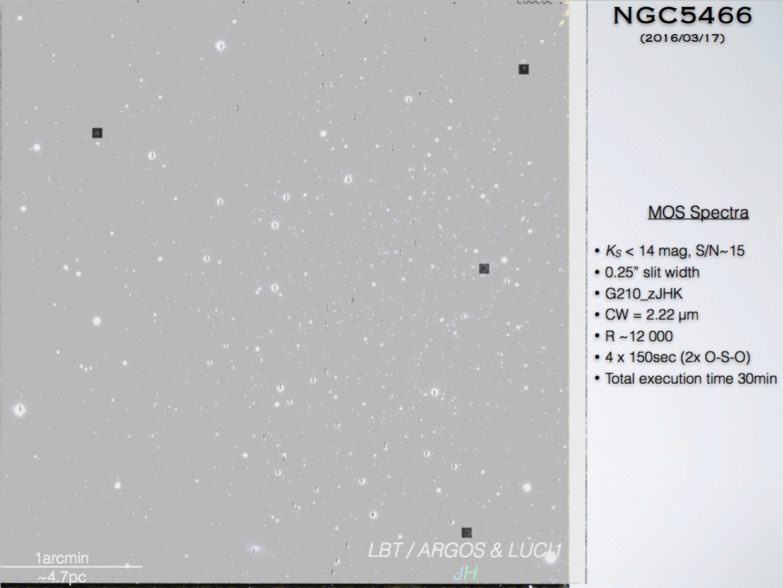
First LGS-AO MOS observation
Courtesy of Iskren Georgiev

Slide 17
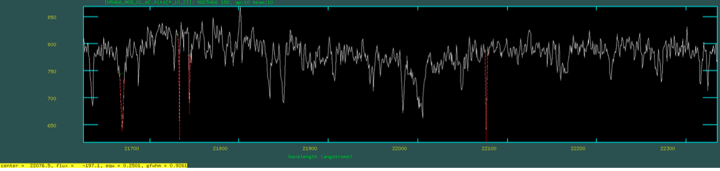
Globular cluster NGC 5466, K-band, LUCI1 camera 3.75
Courtesy of Iskren Georgiev

Slide 18
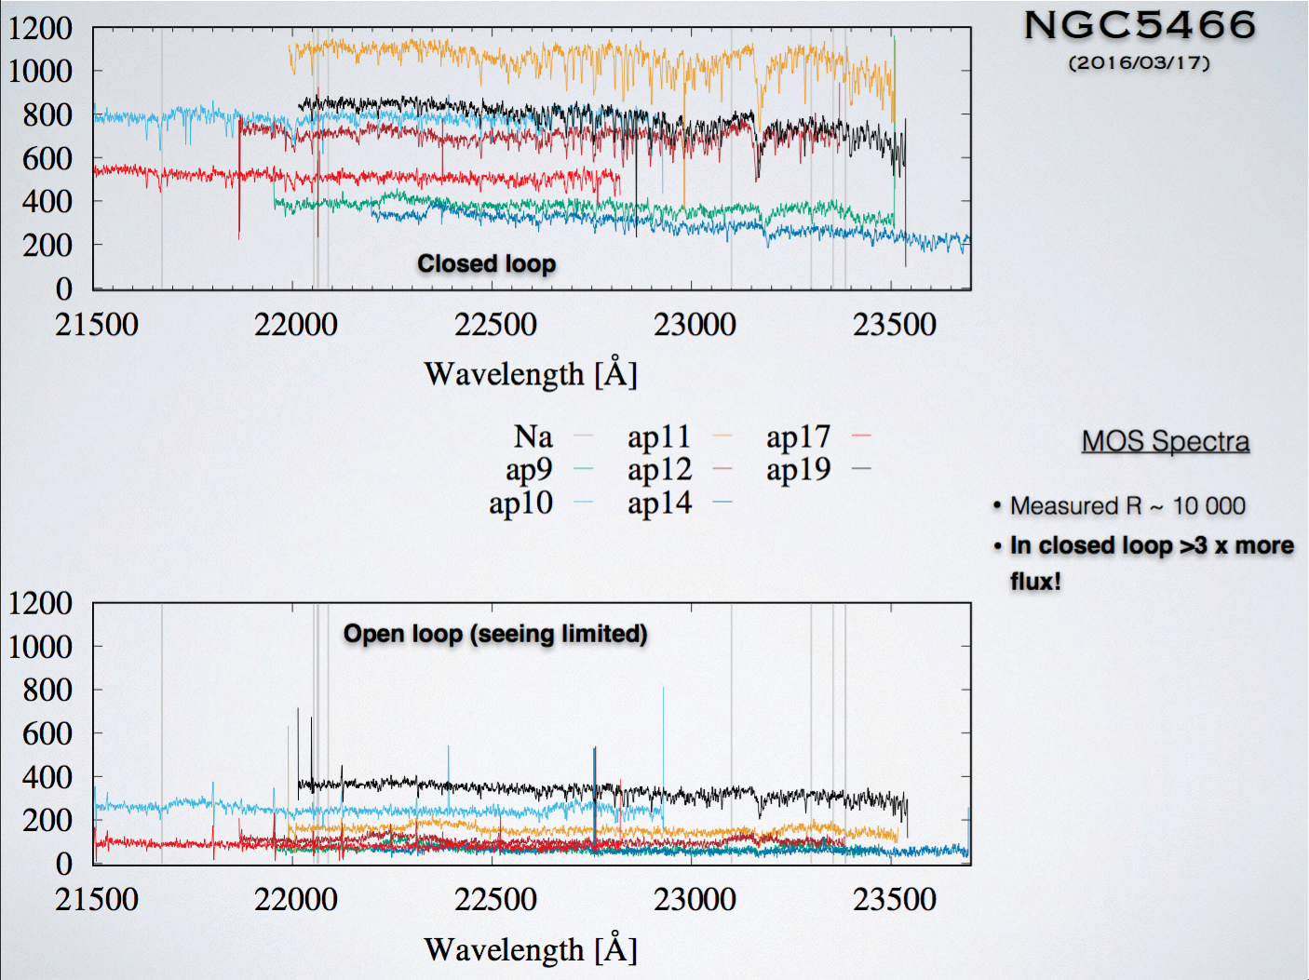
Courtesy of Iskren Georgiev

Slide 19
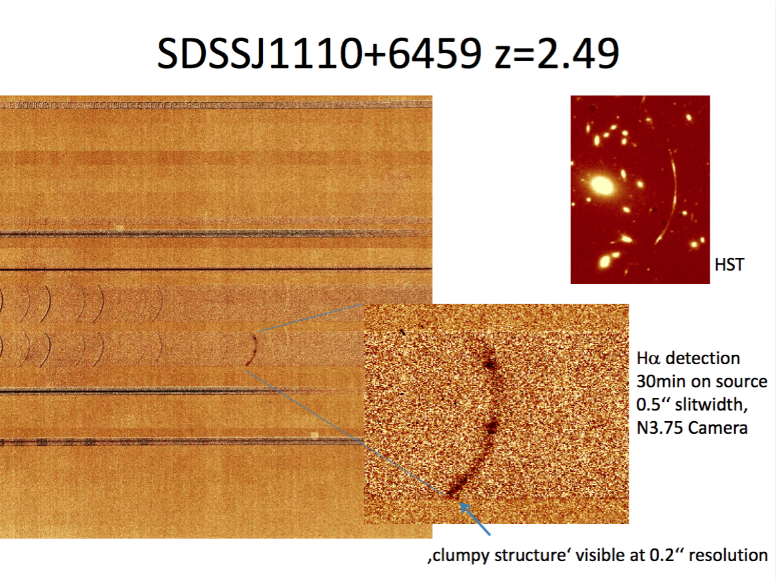

Slide 20
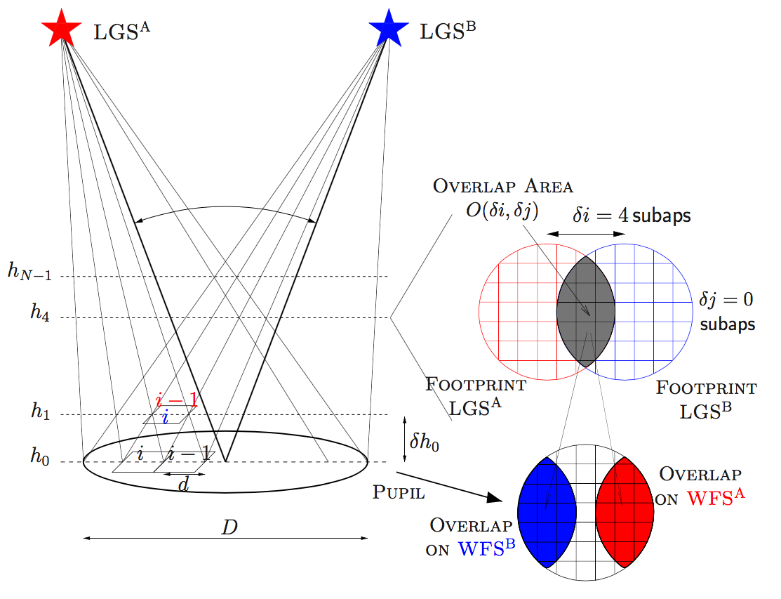
SLODAR with ARGOS
At a given altitude h₁ the footprint of the two stars are shifted of one subaperture; a turbulent layer at h₁ (about 500m) produces a correlation in the signals of the 2 WFS at a spatial-shift of 1 subap.
In ARGOS, the technique can be used to estimate the amount of turbulence in 10 layer up to 3km.
Its accuracy is limited by the finite altitude of the LGS and by the cone effect

Slide 21
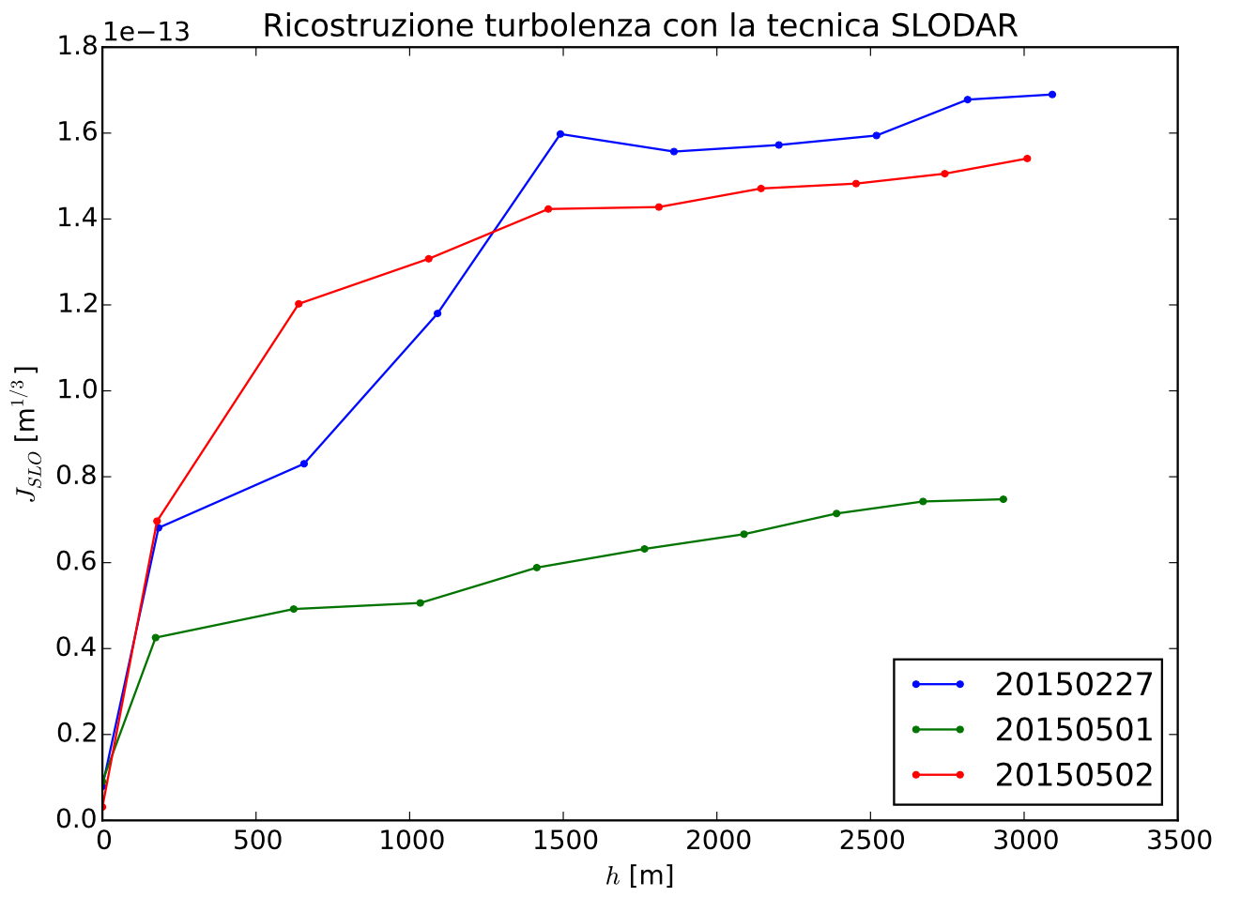
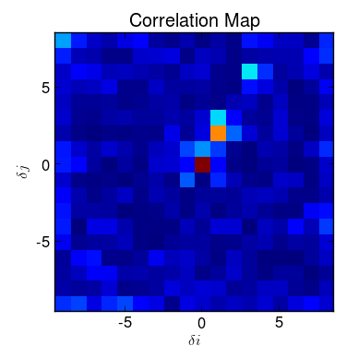
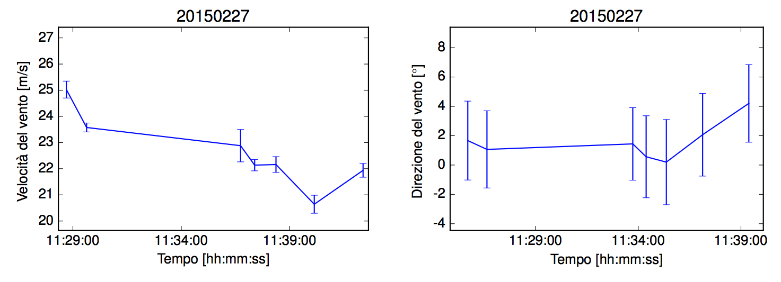
SLODAR
This is some mid-layer turbulence
Cumulative J measured during 3 nights
Measure of the wind, speed and direction, with the time-delayed SLODAR wind Profiling technique.
Wind speed [m/s]
Wind direction [°]
Time [hh:mm:ss]
Time [hh:mm:ss]

Slide 22
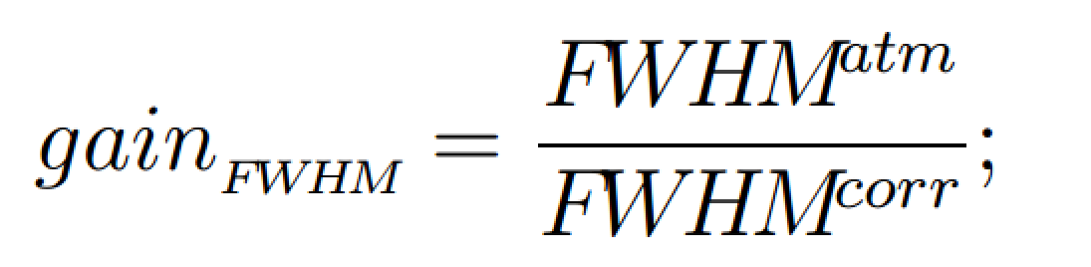
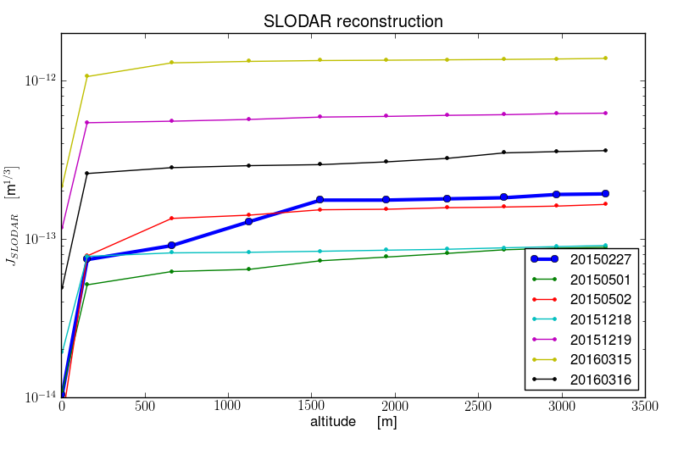
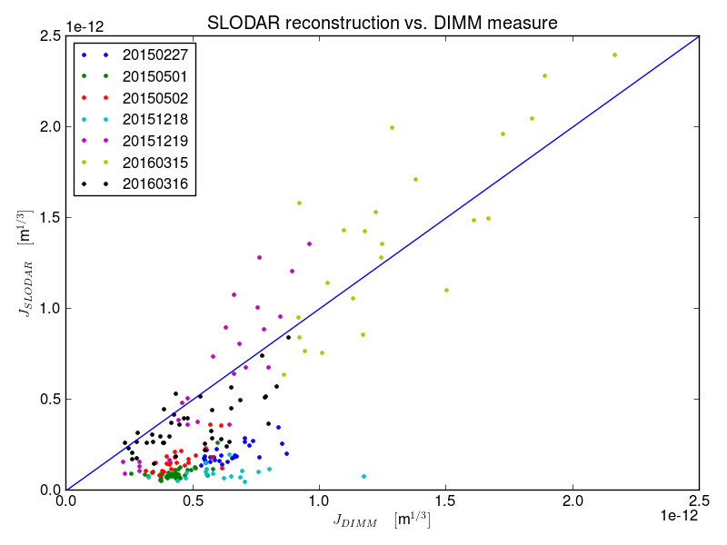
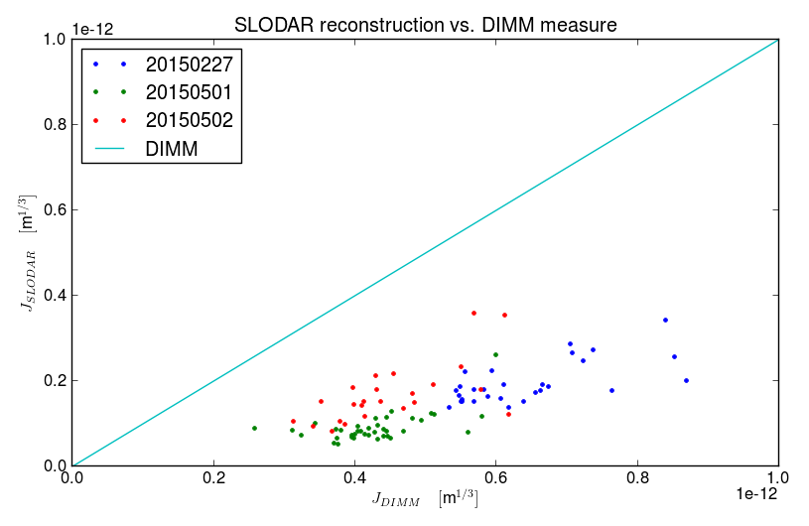
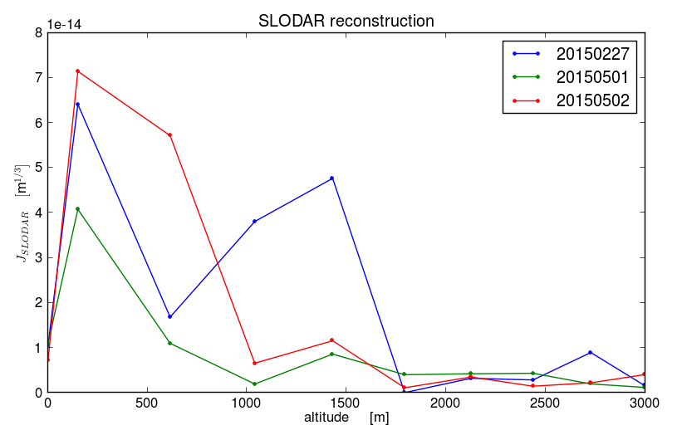
SLODAR
Vertical distribution of the turbulence and GLAO FWHM gain
GLAO gain | 20150227 | 20150501 | 20150502 | 20151219
J Band | - | - | 1.6 | 1.6
H Band | 1.3 | 1.7 | - | 1.9
DIMM seeing > SLODAR seeing ➡ Unseen high-layer ➡ low GLAO gain
Strong mid-layer ➡ low GLAO gain
DIMM seeing = SLODAR seeing ➡ All turbulence < 3km ➡ good GLAO gain

Slide 23

www.mpe.mpg.de/ir/argos
www.facebook.com/argoslbt

