Slide 1

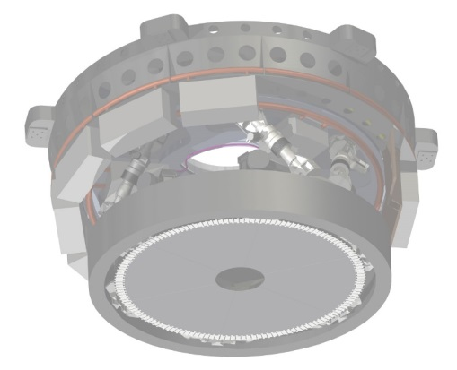
Preparing the optical calibration of the M4-Deformable mirror for the E-ELT
Briguglio, R., Pariani, G., Xompero, M., Riccardi, A.
ADONI meeting, Firenze 12-14 April 2016

Slide 2
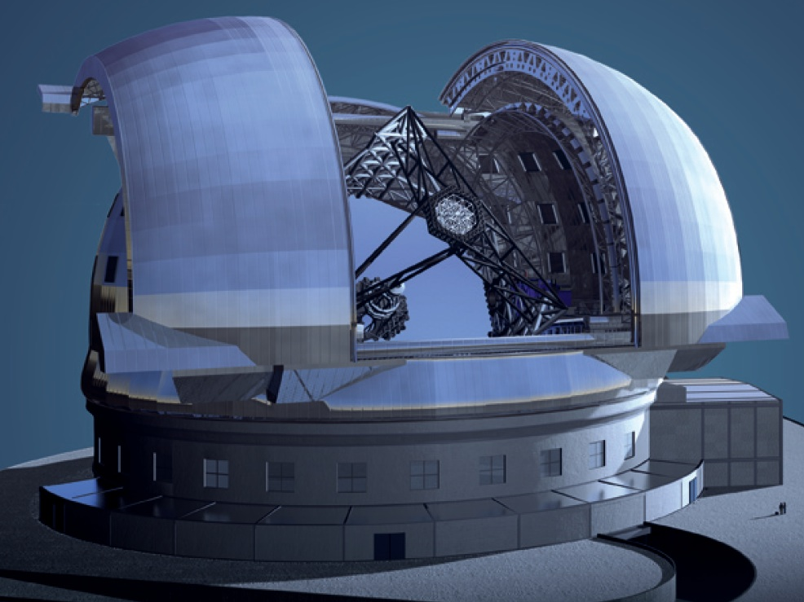
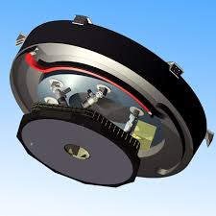
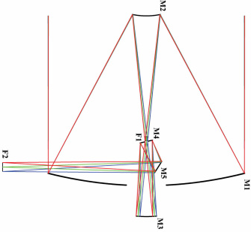
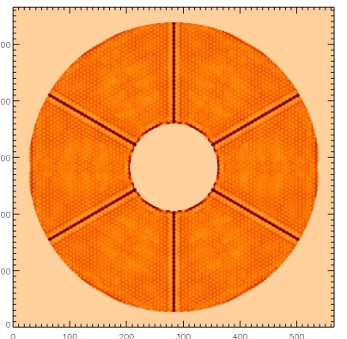
E-ELT & M4
M4: the E-ELT’s DM
  Shape: flat
  A few numbers:
  OD: 234cm, ID: 54cm
  # segments: 6
  # actuators 5316
  on a triangular pattern (3.15cm pitch, 52.5 cm projected on M1)
  Settling time< 1ms
  Fitt. Error, median seeing:
  145 nm WF
  Flattening spec:
  20 nm WF
  Pupil position midway M4/M5:
    → Optical area moves on M4, depending on field
  M5: Tip-Tilt only

Slide 3

E-ELT & M4
M4: the E-ELT’s DM
  Shape: flat
  A few numbers:
  OD: 234cm, ID: 54cm
  # segments: 6
  # actuators 5316
  on a triangular pattern (3.15cm pitch, 52.5 cm projected on M1)
  Settling time< 1ms
  Fitt. Error, median seeing:
  145 nm WF
  Flattening spec:
  20 nm WF
  Pupil position midway M4/M5:
    → Optical area moves on M4, depending on field
  M5: Tip-Tilt only

Slide 4
E-ELT & M4
M4: the E-ELT’s DM
  Shape: flat
  A few numbers:
  OD: 234cm, ID: 54cm
  # segments: 6
  # actuators: 5316
  on a triangular pattern (3.15cm pitch, 52.5 cm projected on M1)
  Settling time< 1ms
  Fitt. Error, median seeing:
  145 nm WF
  Flattening spec:
  20 nm WF
  Pupil position midway M4/M5:
    → Optical area moves on M4, depending on field
  M5: Tip-Tilt only

Slide 5




M4 project
Partners
  ADOPTICA as prime-contractor (companies consortium, MG+ADS)
  INAF as sub-contractor
Allocated Budget:
  ~30M€ (tot)
  ~ 1.3M€/7y (INAF)
  2.5FTE/y
INAF Team:
  Riccardi, Briguglio, Xompero (OAA)
  Pariani (OAB)
  0.5 more persons
  (to be hired)
INAF Tasks:
  AO expertise
  Error budget
  Optical design of Test Tower
  Test plan and procedures
  Support of Tower integration and characterization
  M4 optical test (2022)

Slide 6
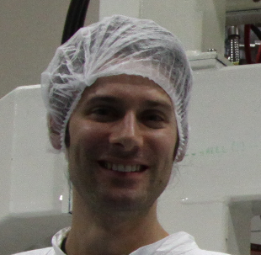
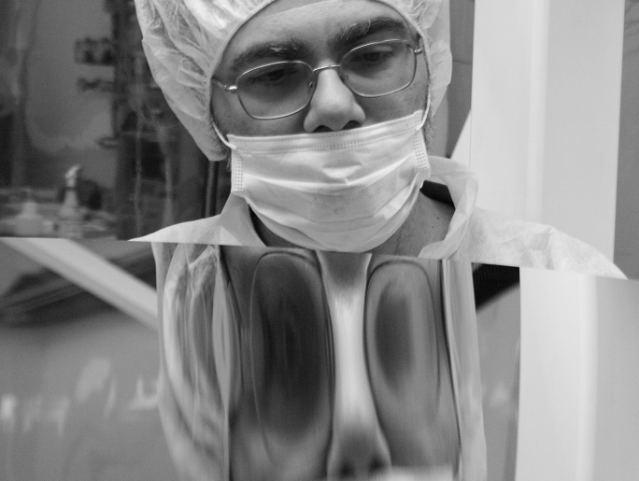
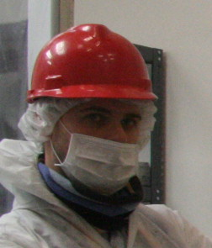
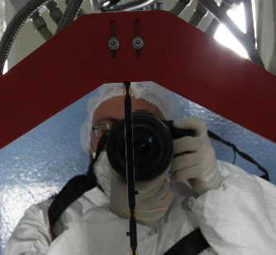
The INAF Team
Giorgio Pariani-OAB
Armando Riccardi-OAA
Marco Xompero-OAA
Runa Briguglio-OAA

Slide 7

However, we fit well into an ADONI meeting
LBT Access road, february 2010

Slide 8
Project timeline
Date | 08/10/2016 | 08/09/2017 | 08/10/2019 | 08/01/2020 | 08/04/2022
Deliverables | Optical Test Setup Critical Design Review | Final Design review | Optical Test Setup Review | Integration readiness review | In-Unit Optical Tests
Optical Test Setup Design | X
Optical test setup specification | X
Compliance Matrix | X |  | X
Engineering Budgets |  |  | X
Optical test setup Verification plan | X
Optical test setup engineering budgets | X
M4 Unit optical tests plan/procedure | X | X |  | X
Optical test |  |  |  |  | X

Slide 9
Overview of on-going activity
Review of the test tower design
    Interferometer replaced
    Optical design: update/sensitivity/risks
    Opto-mechanical fine tuning
2. Test procedure
    Risks/unknowns (experience with LBT/VLT +M4 prototype)
    Simulations

Slide 10

On-going activity 1
Test Tower Revision
lim =
$ → ∞⁺

Slide 11
Test tower concept
SIDE VIEW
M4
TOP VIEW
390
FM
Concept:
Newtonian telescope
F/3.3 beam
45° folding mirror
1.5 m parabolic collimator
Flat M4 to close the cavity
Interferometer, F/3 beam
3350
Parabola

Slide 12
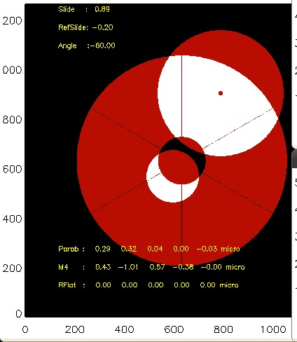
Test tower concept
Interferometer frame
Parabola
Rotating-sliding assembly
M4
Ref Flat mirror

Slide 13
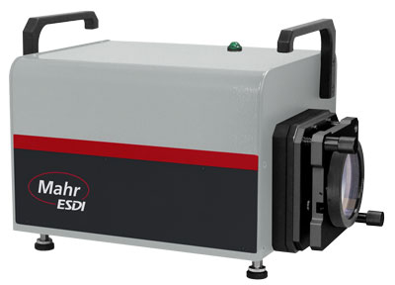

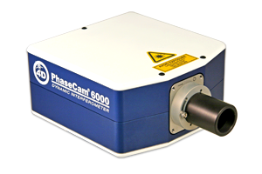
Test Tower Revision
Validation of Fizeau interf. proposed during Phase1
  Dynamic Fizeau: discarded
      Critical internal calibration procedure
      Calibration residuals too large for M4 REQ
  New solution: dynamic Twyman Green
Optical design updated
  Beam expander to implement TG interf.
Validation tests held @OABo & OAB
Thanks to E.Diolaiti, F.Cortecchia, M.Riva

Slide 14
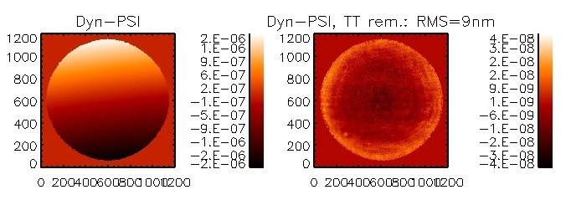
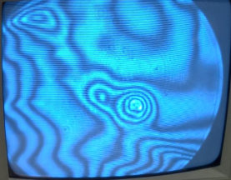
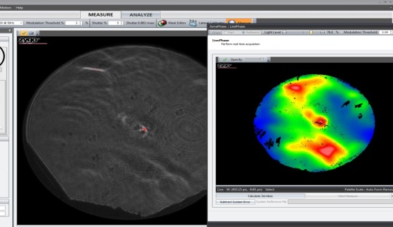
Fizeau?
Dynamic Fizeau interferometer discarded:
Reasons for exclusion: calibration
  Tip/tilt and focus entangled with calibration signal
  Coupling of calibration signal with current aberrations
  Time overhead and risks due to calibration
  (e.g. Mask management)
Comparison between PSI and DYN mode: tip-tilt and focus are shown up. Critical for flattening
Re-trace error (signature) measured through HO cavity: entangled with local WF. Critical for IF and flattening.
Detector mask affected by reconstruction issues, because of very large fringes density. Critical for mask management/schedule.

Slide 15

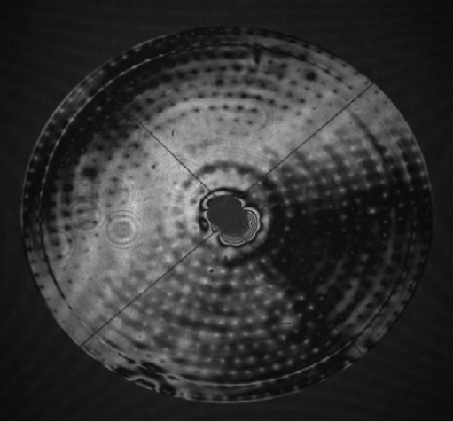
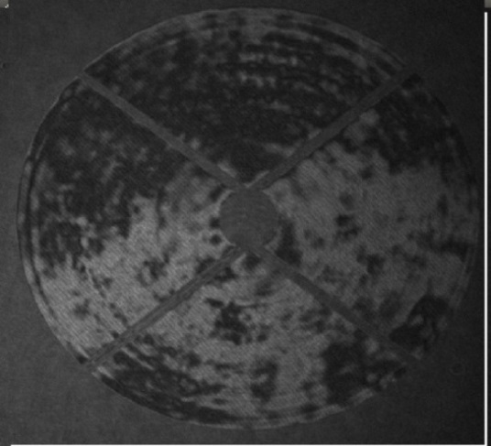
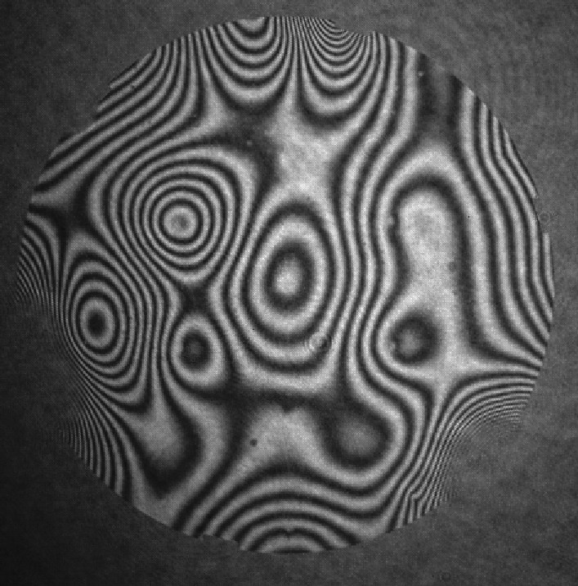
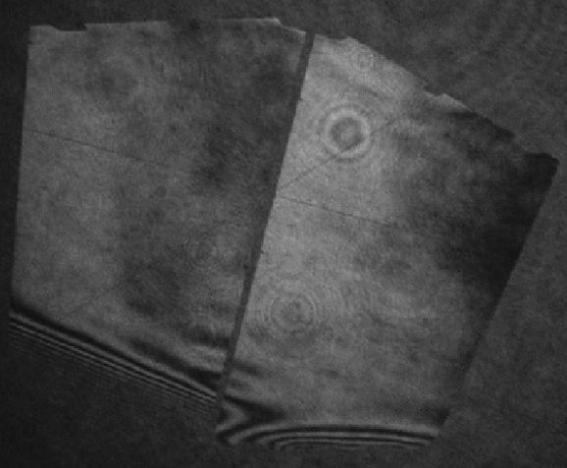
On-going activity 2
Test procedures definition
Our background in DM optical calibration:
Also:
TecnoINAF2010 was devoted to DM calibration
LBT (2x),
Mag
VLT-DSM
LATT
M4DP
2009-2011
2013
2014
2015
1m diam,
672acts
@LBT, @Arcetri
1.2m diam,
1170 acts
@Garching
40cm diam,
19 acts
@Arcetri
2x 30cm x70cm
2x 111 acts
@Merate
Also tested by Merate
SPIE 2010
AO4ELT3- SPIE2014
ICSO2015
SPIE2016
AO4ELT4

Slide 16

M4 is different: è petaloso!!!
  Segmented system (2x tested with M4DP)
      Management of block-diagonal command matrix
      Management of mask islands
      Measurement/correction of global shape with local commands
  Images composition (interf beam << M4)
      Measur./Correction of continuous modes on partial frame
      Management of CPA vs segment aberrations
  Very tight specifications
      20 nm WFE, including phasing+polishing
  Test tower: 6 m
      Convection, vibration, thermoelastic bending

Slide 17
M4 is different:
  Segmented system (2x tested with M4DP)
      Management of block-diagonal command matrix
      Management of mask islands
      Measurement/correction of global shape with local commands
  Images composition (interf beam << M4)
      Measur./Correction of continuous modes on partial frame
      Management of CPA vs segment aberrations
  Very tight specifications
      20 nm WFE, including phasing+polishing
  Test tower: 6 m
      Convection, vibration, thermoelastic bending

Slide 18
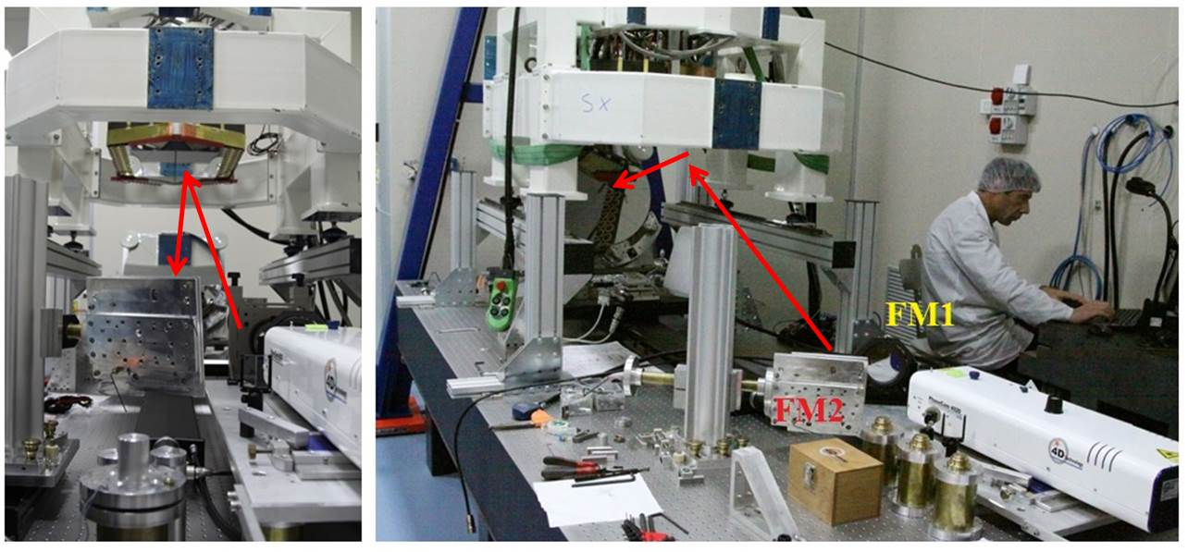
The optical calibration of M4DP was a lesson learned:
  Management of segments:
      Commands
      Masks
      InfFunct
  Measurement/unwrapping of diff piston
  Measurement of piston InfFunct
      LO Modes command amplitude must be << λ/4
      We need a new command basis
☑
☑
☑
OAA+OAB:
February-March 2015
Optical setup @ Merate
Results
-Flattening: 12 nm RMS WFE
-Diff piston accuracy: 5 nm WF
-Test on convection noise
-Noise vs diff piston
-Optimal control of differential tilt:
InfFunct absolutely referenced in tilt with the not-active shell

Slide 19
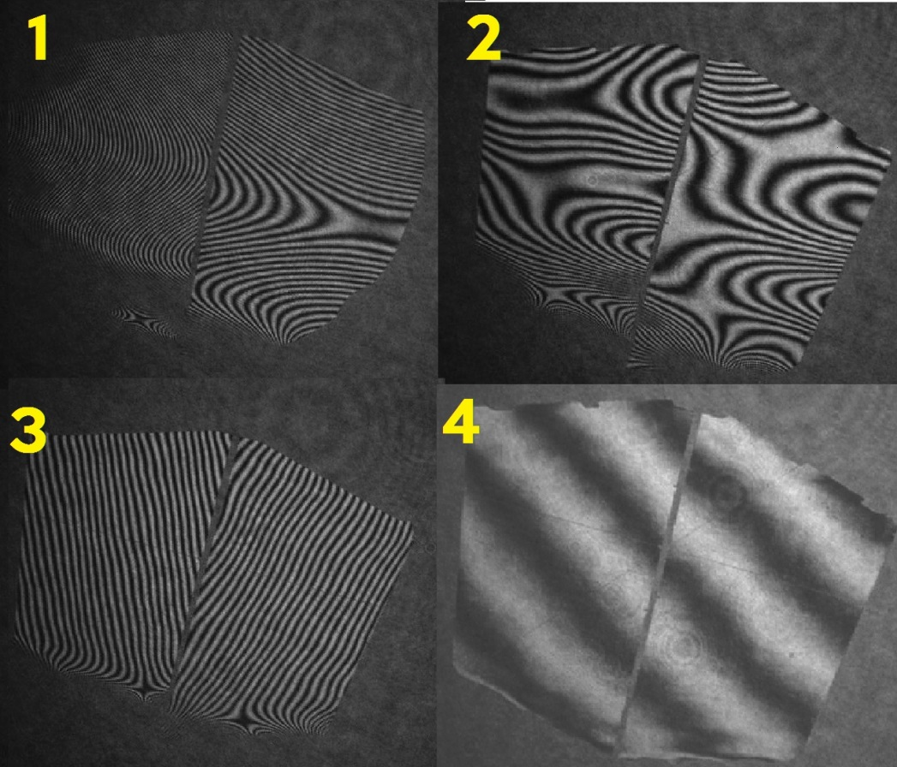
Results on the M4DP
1: Initial shape
2: 2x10 modes flattening
3: high orders flattening, no phasing
4: whole system flattened and co-phased
70 cm
WFE: 12 nm RMS

Slide 20
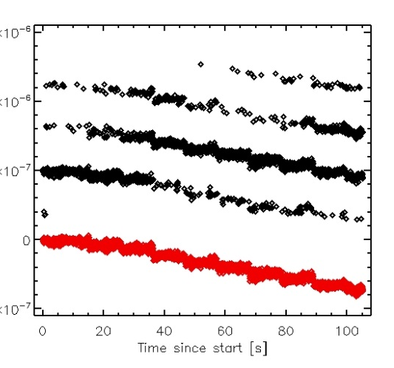

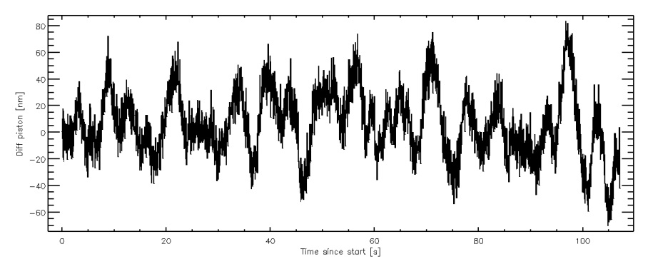
Still many open points
How to measure effectively the piston IntMat, despite the interf. phase ambiguity?
How to compute global commands
from single local measurements?
What is the best management strategy for the interferometer island masks?
How to cope with bench noise?
Nλ jumps
Diff piston noise: 150 nm PtV@25Hz

Slide 21
Introducing 8s: Optical Test Tower Simulator
8s is a simulation SW producing phase maps of the OTT.
Written in IDL
Model from FEA and ZEMAX
The user may command/modify:
Tower geometry/ configuration
M4 actuator command
Optics position
Optics figuring and markers on/off
Vibration noise , diff piston on/off
Simulation strategy
Data processing
Test procedures
OTT Data
OTT WFmap
Segment mask
OTT geometry
Green: input from operator
ZEMAX/FE model
Noise
Optics position
Act command
Notes:
Espandere un pò le cose fatte...

Slide 22
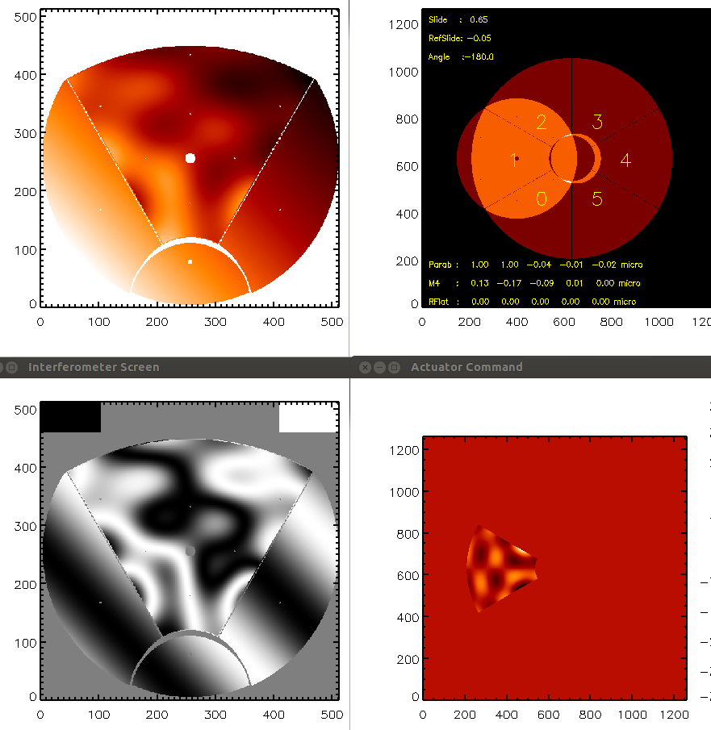
Introducing 8s: Optical Test Tower Simulator
8s is a simulation SW producing phase maps of the OTT.
Written in IDL
Model from FEA and ZEMAX
The user may command/modify:
Tower geometry/ configuration
M4 actuator command
Optics position
Optics figuring and markers on/off
Vibration noise , diff piston on/off
Phase map
Geometry
Interferogram
Act.Command
Simulator output
Notes:
Espandere un pò le cose fatte...

Slide 23
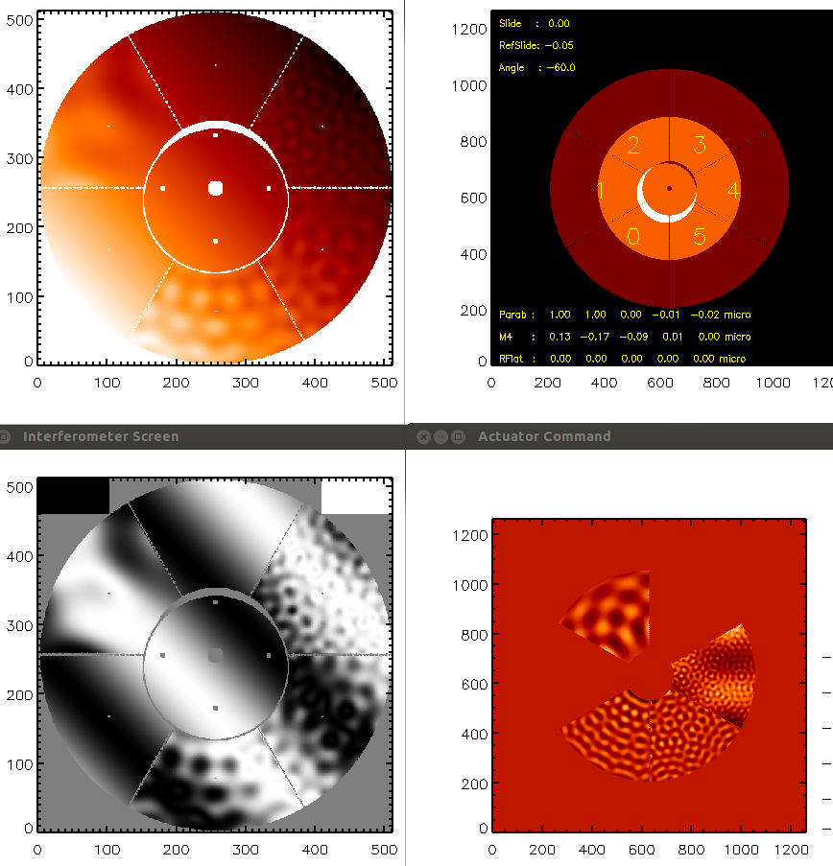
Introducing 8s: Optical Test Tower Simulator
8s is a simulation SW producing phase maps of the OTT.
Written in IDL
Model from FEA and ZEMAX
The user may command/modify:
Tower geometry/ configuration
M4 actuator command
Optics position
Optics figuring and markers on/off
Vibration noise, diff piston on/off
Notes:
Espandere un pò le cose fatte...

Slide 24
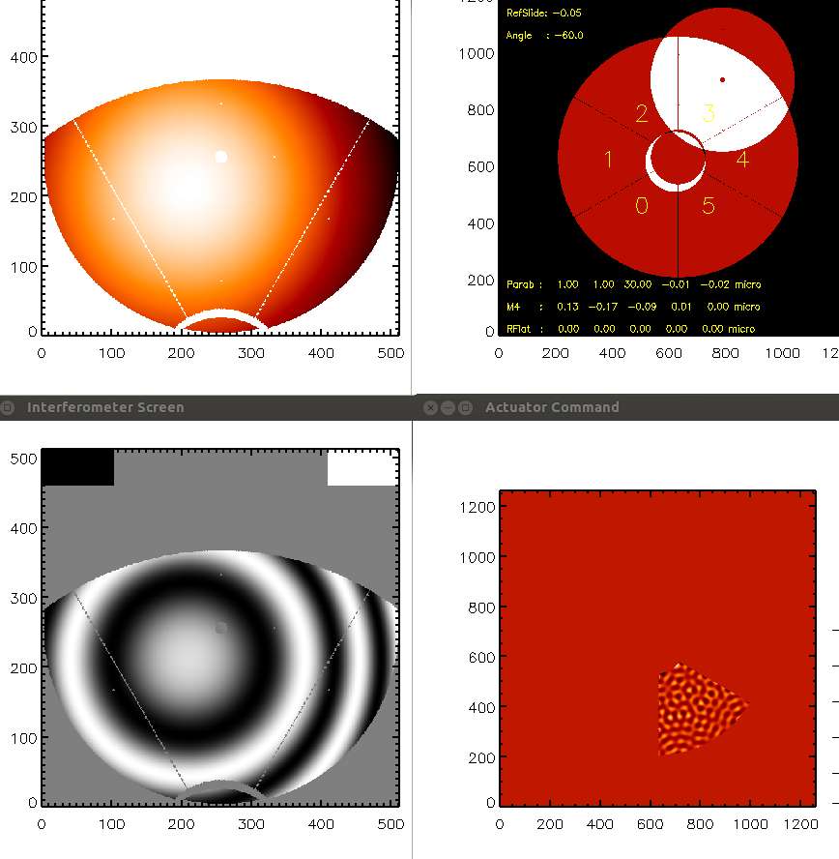
Introducing 8s: Optical Test Tower Simulator
8s is a simulation SW producing phase maps of the OTT.
Written in IDL
Model from FEA and ZEMAX
The user may command/modify:
Tower geometry/ configuration
M4 actuator command
Optics position
Optics figuring and markers on/off
Vibration noise, diff piston on/off
Notes:
Espandere un pò le cose fatte...

Slide 25
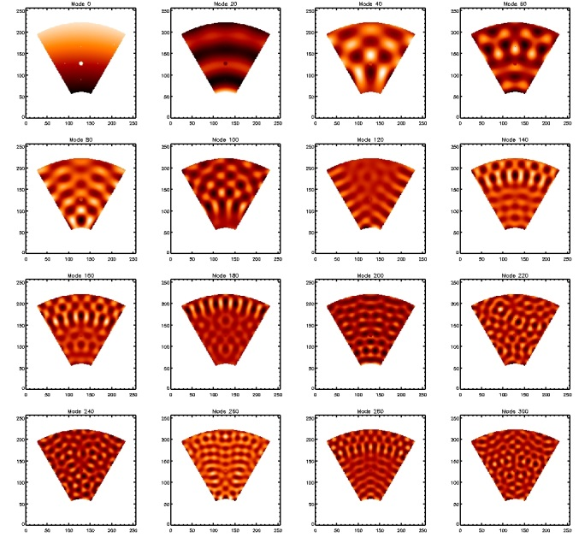
Work in progress with 8s
Alignment procedure with reference flat
Single segment Interaction Matrix
Single segment flattening
Tip/tilt IntMat with partial segment visibility
Flattening of differential tip/tilt with partial segment visibility
‘Piston friendly’ modified command matrix
Piece of cake, mostly a system validation
Mmat = [v₀ v₁ v₂]
Modified Mmat:
v0’ = recmat # piston
v₁’ = v₁-v₀’
v₂’ = v₂
piston(v₀)=1
piston(v₁)=0
piston(v₂)=0
Notes:
Espandere un pò le cose fatte...

Slide 26
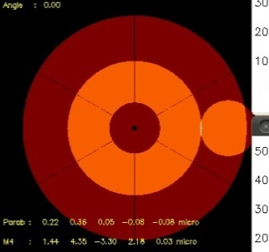
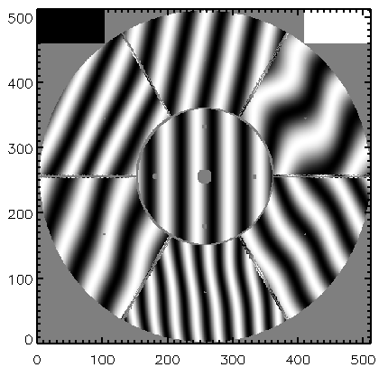
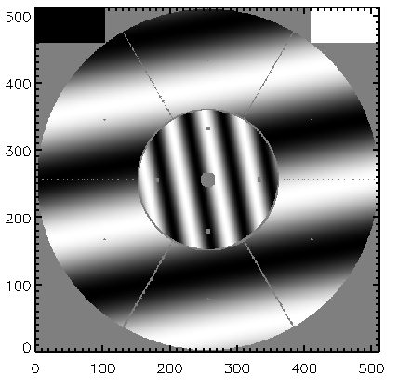
Work in progress with 8s
Alignment procedure with reference flat
Single segment Interaction Matrix
Single segment flattening
Tip/tilt IntMat with partial segment visibility
Flattening of differential tip/tilt with partial segment visibility
‘Piston friendly’ modified command matrix
TTmat = [(2x6)x5136]=
[Tip0 Tilt0 0 0 .....
0 0 Tip1 Tilt1 .....
0 0 0 0 .....
0 0 0 0 ..... ]
Tip = <Mmat|Tip> |Mmat>
Mmat = [v₀ v₁ v₂]
Modified Mmat:
v0’ = recmat # piston
v₁’ = v₁-v₀’
v₂’ = v₂
piston(v₀)=1
piston(v₁)=0
piston(v₂)=0
Notes:
Espandere un pò le cose fatte...

Slide 27
Work in progress with 8s
Alignment procedure with reference flat
Single segment Interaction Matrix
Single segment flattening
Tip/tilt IntMat with partial segment visibility
Flattening of differential tip/tilt with partial segment visibility
‘Piston friendly’ modified command matrix: now to be tested with diff piston noise
Modified command matrix:
|v₀’> = <v₁|Zpiston> | v₁>
|v₁’>= (1- <v₀’|v₁ > )v₁>
|v₂’>= |v₂>
Mmat’ = [v₀‘ v₁ ‘ v₂’]
<Zpiston|v₀>= 1
<Zpiston|v₁>= 0
<Zpiston|v₂>= 0
Original command matrix:
Mmat = [v₀ v₁ v₂]
V0: mode 0
V1: LO modes (1:40...)
V2 : others (41:end)
Notes:
Espandere un pò le cose fatte...

Slide 28
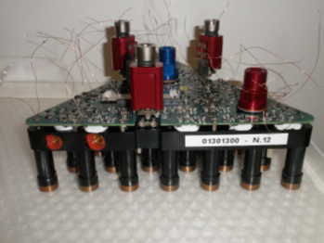
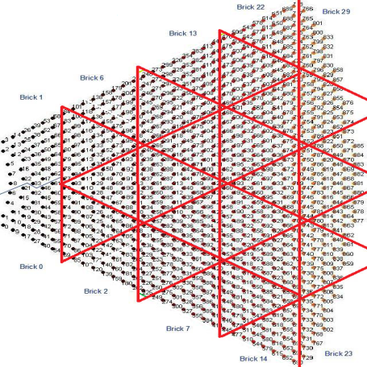
What’s next?
microOTT for test cases assessment
  Reduced scale OTT or
  Test-specific laboratory setup
Study on system calibration with FEA
  Lead by C. Del Vecchio
  Well fitting M4 modularity

Slide 29
Summary
INAF is involved in M4 project
    2.5 FTE, 1.3 M€ / 7 years
    Tasks: AO expertise, optical test
Current activity
    Review of the optical test tower
    Definition of the calibration procedures
Optical test of M4 is a challenge
    Segmented system, local visibility, global performance
    Tight specifications
    Simulation in progress to assess the strategy

Slide 30
Thanks for your attention stay tuned for flattening in 2023

Slide 31
Update of Parabolic mirror spec.
Two possible SPEC definitions
Via simulation:
  We define a polishing quality spatial distribution
  Montecarlo generation of phase maps
  Computation of subtraction residuals
  Check of specifications
Direct computation of subtraction residuals
Pix:
resolution element
3 nm → 6 nm WF
→ 12 nm WF DPass
The tightest SPEC is SurfError:
Slope error and Curv Radius are met after SurfError is met
S = PM Surf Map
dS= S- shift(S, 2pix, 2pix):
dS < 3 nm RMS

