Slide 1
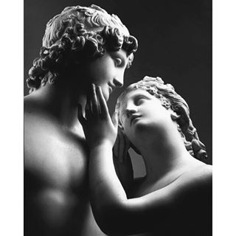
The MAORY Simulation Tool
C. Arcidiacono, L. Schreiber, G. Bregoli, E. Diolaiti, Mauro Patti, M. Lombini
OA BOLOGNA

Slide 2
Why do we need a sim tool?
Ma funziona?
Concepts validation
PYR is better than a SH ? Best Wavelengths?
Top Level Requirements / Performance definition
What performance can you get with our chosen PYR / DM ?
Provide PSFs to astronomers for science simulations / ETC
System design / component and tolerances specification , PDR Error Budget!
How well do you need to align the PYR wrt. DM ?
Real Time Computer Algorithm Simulations
Calibration Strategies definition
System performance validation [A posteriori]
in lab / on the sky we get what we simulated?
R&D
New rec algorithms, testing of new concepts
A o B ?
Bello, si, ma la PSF?

Slide 3
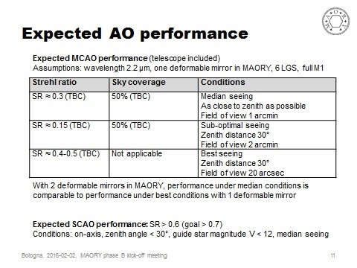
2 years PHASE B Study

Slide 4
Good AO Simulator for EELT scale
For reference: http://cfao.ucolick.org/software/
End 2 End, Montecarlo codes
YAO, YORICK&C, Rigaut, Van Dam, http://frigaut.github.io/yao/
DASP Python&C, [Basden, A, MNRAS, 2015]
COMPASS, C++&CUDA, LESIA, https://projets-lesia.obspm.fr/projects/compass/wiki/Wiki
MAOS C&CUDA, https://github.com/lianqiw/maos, old LAOS in matlab
Octopus C, multipc, ESO, [Le Louarn, M & al, SPIE 2012]
PASSATA, Agapito, G., Puglisi, A. & Pacheco, F., IDL& CUDA&C++
?CAOS, LOST, ecc..?
Spatial frequency domain, analytical codes
PAOLA, IDL, Jolissant, L.
CIBOLA, matlab, Ellerbroek, [http://cfao.ucolick.org/software/cibola.php]

Slide 5
Why do we need a NEW sim tool?
Because we need to know in which way the algorithm are written to check whether an effect is “true” or is software joke.Examples:
L_0
Shack Hartmann Lenslet FoV
Another reason is because of the possibility to have a tool you may upgrade in a easier way.
Add a different WFS
Of course we trust all the other tools..

Slide 6
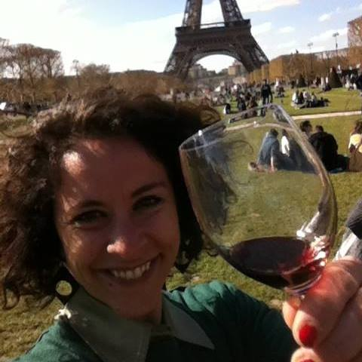
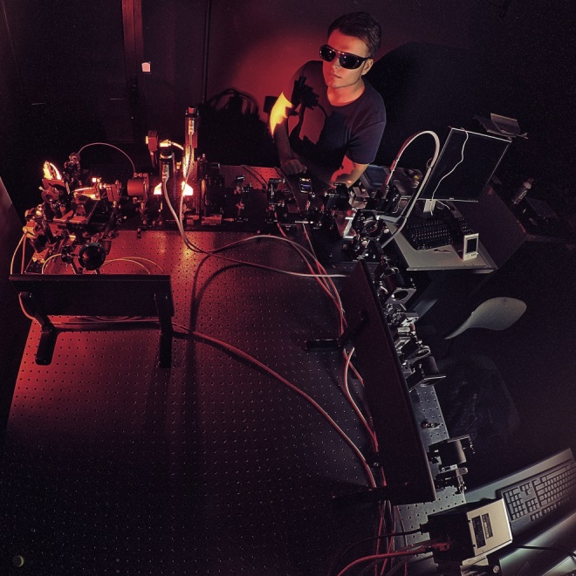
Name and names
The name I like is mao “Maory Adaptive Optics”
The people involved in editing the code are me, Laura Schreiber and Giovanni Bregoli.
Matto Lombini and Mauro Patti support by checking in lab LGS specifics effects.
Sylvain Oberti do the code cross checks and gives input from ESO and AOFacility.

Slide 7
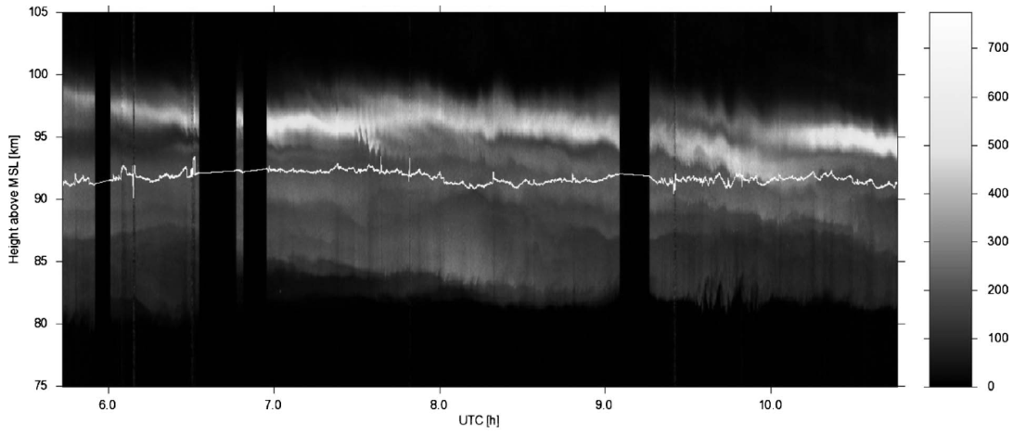
MAO features
We design a software to simulate ELT AO / large AO systems
Reasonably fast on LARGE systems. Not optimized for small systems;
End-to-end (Monte Carlo: sensor noise and phase screens);
Many effects included (alignments, actuator geometry, …)
Reconstructor is MVM, may include inverse, bad modes cut, MMSE
Several WFS types SH (with spatial filter if needed), PYR (incl. modulation), Linear WFS fast (with many noise models), Quad Cell
OL, SCAO, GLAO, MCAO can be simulated
LGS specific aspects, sodium layer intensity profile evolution +
Uplink Beam [Spot Wandering]
Cone effect
Spot elongation: central/side launch, non gaussian profiles,…
Different centroid algorithms
PRESENTAZIONE DI MAURO PATTI!!!

Slide 8
General principles of MAO – Open loop
{
Input IDL structures generation
Atmosphere simulated by von Karman/Kolmogorov spectrum phase screens and stored
Open Loop Phase at telescope is the sum of the phase screens in one particular direction (geometric propagation)
Phase screens evolve to mimic temporal evolution (by wind – frozen flow hypothesis) and Open Loop history file is stored
On/off axis aberration and telescope effects added to the Open Loop history
.sav
Atmospheric Layers generation
.fits
Wavefronts generation
.fits
Telescope aberrations
.fits
Influence functions
.fits
Interaction Matrix calibration
.fits
Control Matrix
.fits
Closed Loop correction
.fits
PSF generation
Analisys
.eps
.fits

Slide 9
General principles of MAO – DM and Control
Input IDL structures generation
Deformable mirrors:
Zernike
Influence Function
Karhunen Loeve from Zernike or from Infl. Funct.
Interaction Matrix Calibration
Push Pull sequence
Various background condition [Atmo,Lab,..]
Control Matrix computation
Inverse/Pseudo Inverse [Truncated or not]
minimum mean square error (MMSE)
The Kaczmarz solution doesn’t need the reconstructor.
.sav
Atmospheric Layers generation
.fits
Wavefronts generation
.fits
Telescope aberrations
.fits
{
Influence functions
.fits
Interaction Matrix calibration
.fits
Control Matrix
.fits
Closed Loop correction
.fits
PSF generation
Analisys
.eps
.fits

Slide 10
General principles of MAO – Closed Loop
Input IDL structures generation
Open Loop is combined to the DM shape to get residual WF
The phases of the guide stars are input for the WFS model/algorithm that returns slopes
From the slopes vector the commands to the DM(s) delta commands are calculated
DMs shapes are calculated from Influence Function or from modal base, considering the temporal behavior/inertia of the DM [pure integrator with delay, low pass filter ord 1 or 2]
The DMs are subtracted from the open-loop for all the field stars considering the delay and DM command vector updated.
Residual phases are stored and loop goes back
Eventually Close Loop phases are saved into file and may be used to generate PSF or for analysis
.sav
Atmospheric Layers generation
.fits
Wavefronts generation
.fits
Telescope aberrations
.fits
Influence functions
.fits
Interaction Matrix calibration
.fits
{
Control Matrix
.fits
Closed Loop correction
.fits
PSF generation
Analisys
.eps
.fits

Slide 11
And eventually
STREHL RATIO
PSF
WF Resid.
Nice MAP

Slide 12
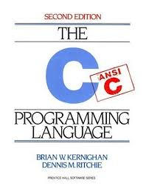
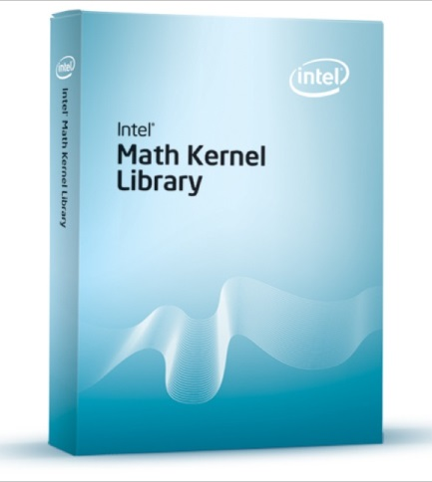
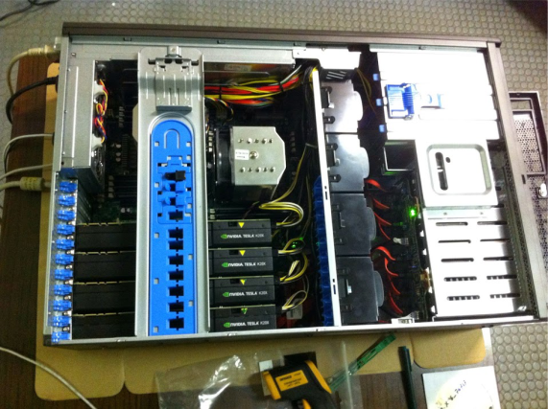
Software and Hardware
Main code is IDL, good for Linux and Windows
Optimized FFTW routines and from Intel Math Kernel Lib are available only in Linux and accessible from IDL
Multithreaded algorithms:
Some smart C++
Some dummy multi IDL sessions.
PSF generation in CUDA on GPU or IDL on CPU
Pyramid and SH only on CPU.
MAO was optimized for MAORY on the 4TESLA_GPU/12Core/256Gb RAM Workstation:
LGS algorithm are in CUDA on GPU
PSF Generation in CUDA on GPU
MAO gains in speed adding more CPUs and adding more GPUs [+2] to match LGSs number.

Slide 13
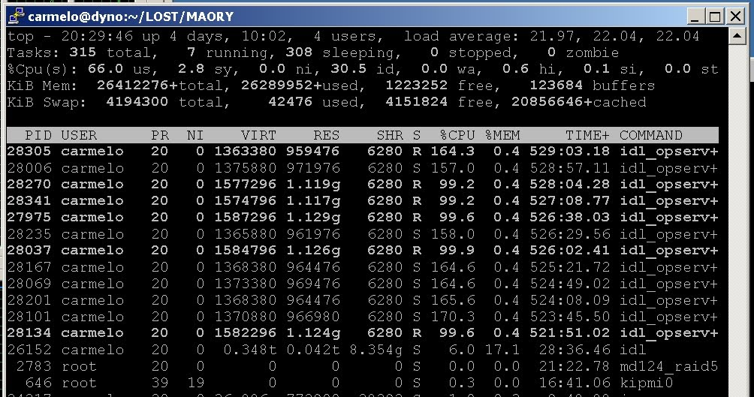
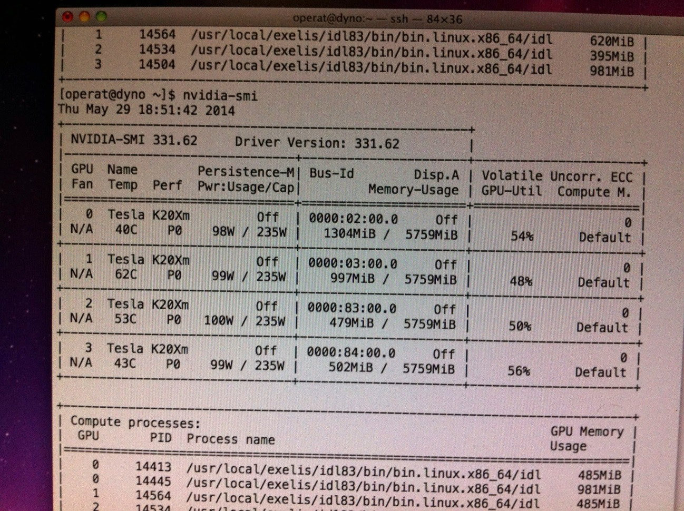
More on IDL multithread

Slide 14
Code Validation and Speed
Wrt to analytical formula [fitting error, Cone effect, Temporal Error]
Comparison with ESO-Octopus for MAD and more cases
A Fast Mode available by applying semi-analytic model of the WFS noise.
Time for 3sec e2e simulation of MAD 10min from 7Layer to 5x5 grid PSF
Time for e2e simulation of NGS MAORY from 35 Layer to 6x6 grid PSF [no Karhunen Loeve from IF] ~1h
Modulated PYR ~ 0.5Hz
Laser LGS ~ 0.25Hz

Slide 15
Difficulties with MAO: physicist vs engineer paradigm
MAO is based on IDL:
Easy to update and debug
parallelization is not straightforward
Code performance are not optimal
MAO is being developed by physicist, so the structure is not the best software structure, the code is continuously debugged and it is somewhat floating.. but in this way we [AO developers] may have the control of the capabilities and it is not crystalized on a fixed version.
Different level of “verbosity”

Slide 16
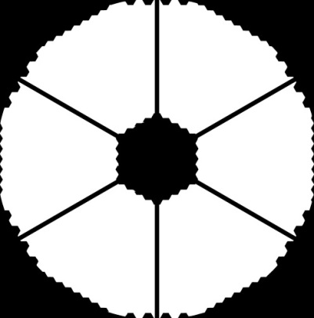
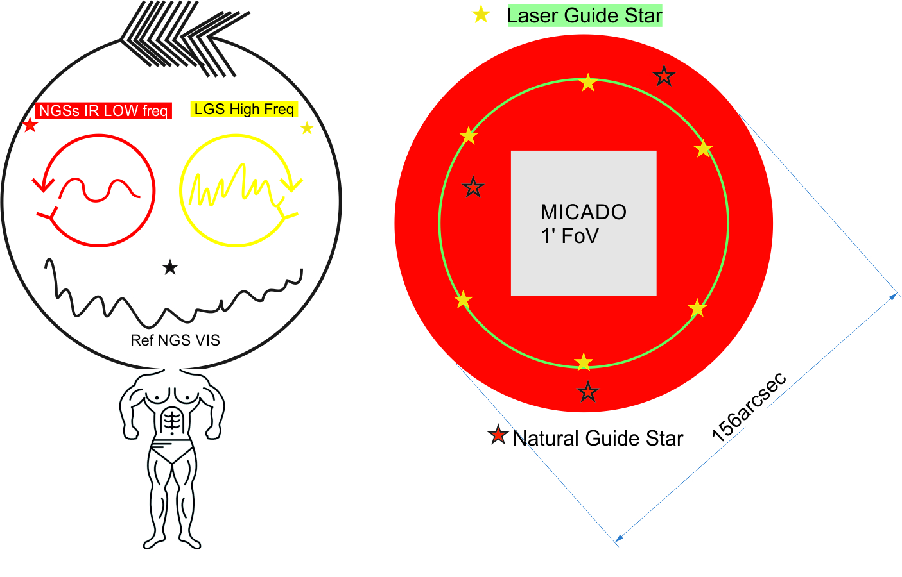
EELT MAORY Specifics
MAO was design to match the LGS/NGS/Reference nested loop scheme of MAORY. Easily can be downgraded to easier systems.
EELT pupil
EELT on axis aberrations
EELT M4 influence function and low pass filter description
Sodium layer profile
Armazones Turbulence Profile

Slide 18
Status
Missing
LGS multi GPU code is still not available from IDL (we have now only the original IDL code)
Available
SCAO, GLAO, MCAO available with different reconstruction solution
Kaczmarz loops
MAORY Fast version
Karhounen Loeve from IF
IF physical model
LGS and Sodium Layer Open Loop and Geometry
Telescope Aberrations
Single LGS GPU
Recently Checked
MAD MCAO SH
LGS cone effect
Currently Checking
MMSE
Currently testing
Astrometric Distorsion
Atm Outerscale Effects

Slide 19
Conclusion
We are continuously developing code
Debug is still running
Full MAORY simulation are available and soon also in a faster mode
A lot a work is foreseen now for the setup of the baseline scheme:
best control matrix and in general control solution
Way to deal with Lasers issues as spot truncation and sodium layer variation

Slide 20
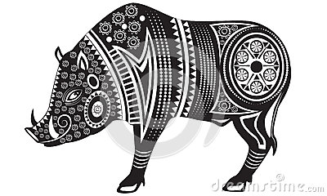
Grazie

